Slide 1
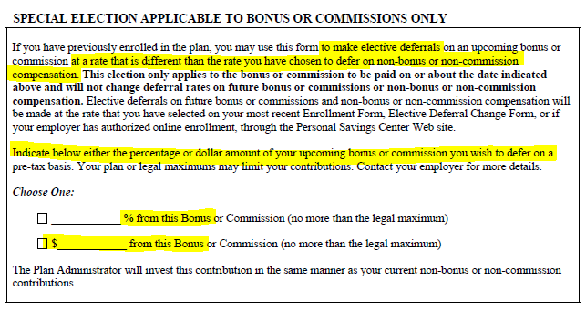
Discretionary Employee Incentive Program 401K Elective Deferrals
If you are enrolled in 401K elective deferrals with a percentage-based deduction, this deduction amount will automatically apply to UH’s Discretionary Employee Incentive Program compensation.
You can opt out or make changes to your 401K deferrals by completing The Standard’s “Special Elective Deferral for Bonus” Form and submitting it to Payroll/HR.
Reminder will be sent in the February Insider, along with a survey link to indicate whether you will be opting out.

