Slide 1
v
MTM Link Facility Portal Training| PST
Edited on 05/15/2020

Slide 2
Course Objectives
After this course you will know how to:
View and work with facility, member and trip information
Schedule single trip requests
Review, schedule and extend recurring trips
Troubleshoot basic issues

Slide 3
General Information

Slide 4
IMPORTANT NOTICE
Routine trips entered into MTM Link Portal should be scheduled by 2 business days prior to the appointment
Urgent and short notice trips under 2 business days should be called into MTM

Slide 5
Credentials
User credentials (Username and Password) will be provided by MTM’s Community Outreach Trainer upon request
Information required to create new user credentials:
First and last name
E-mail address with facility domain
Affiliated facility name and location

Slide 6
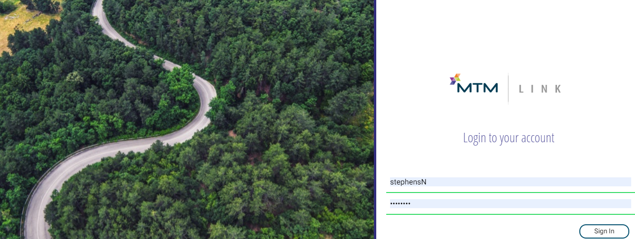
Navigation
Using Google Chrome, type in the following URL address to navigate to the MTM Link Portal login page: https://pst.mtmlink.net/www/link/#/login
Enter Username and Password to Sign In

Slide 7
Daily View

Slide 8
Daily View
Once logged in, users will see a Daily View of all trips going to/from their facility
Daily View can be exported and printed
From this screen users can :
View trips or recurring reservations by selecting the appropriate tab at the top
View how many trips are scheduled for a specific day
Export or download a list of daily trips
Create a custom search by selecting and filtering specific criteria
Cancel a member’s trip
Request a new trip
Access to extend a recurring reservation
**Recurring Reservations cannot be exported or cancelled in MTM Link Portal**

Slide 9
Daily View
Select tab to view single trips or recurring reservations
Request a new trip
Total number of trips for a specific date
Export or download trips
Search Criteria Fields
Daily trips to/from facility

Slide 10
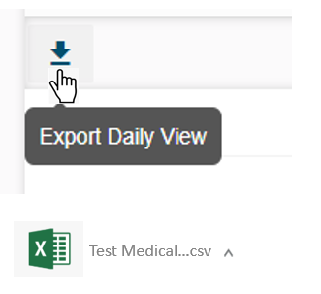
Downloading/Exporting Trips
Click the down arrow and trips will export to an Excel spreadsheet

Slide 11
Filtering Trips
By clicking on the FILTER icon, users can adjust search criteria by date, location, member (last name), trip status, trip type or mode
You can enter information in more than one field
Once desired search criteria has been entered, click APPLY

Slide 12
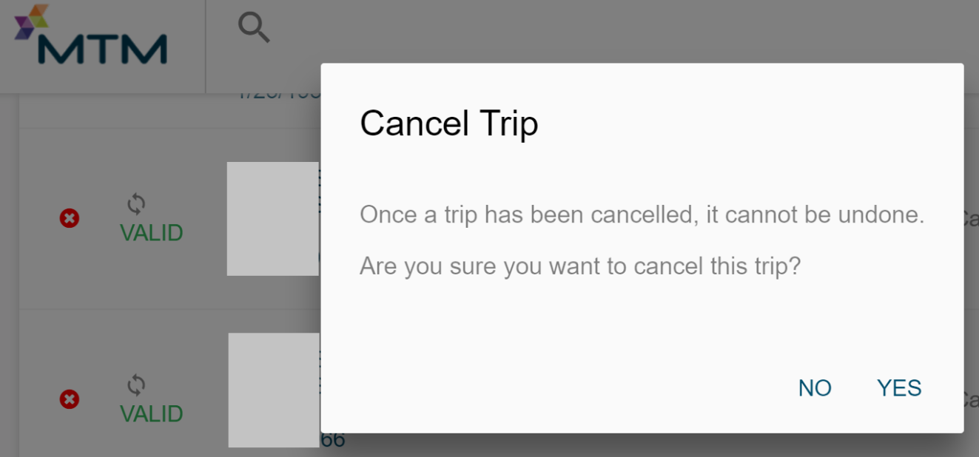
Cancelling Trips
Click the red X to the far left of the trip leg you would like to cancel
Notification box will appear asking for confirmation of the cancellation
Cancel both Arrival and Departure legs to cancel entire trip
Day of cancelations must be called into MTM

Slide 13
Member Search
To view a specific member’s trips, click on the magnifying glass at the top left of the screen
Enter in a minimum of 3 input fields and click SEARCH

Slide 14
Member Details
To view Member Details, click on member’s name

Slide 15
Member Details
Member details will show:
Member Information
Single trips
Recurring Reservations

Slide 16
Trip Details
To view Trip Details, click on location

Slide 17
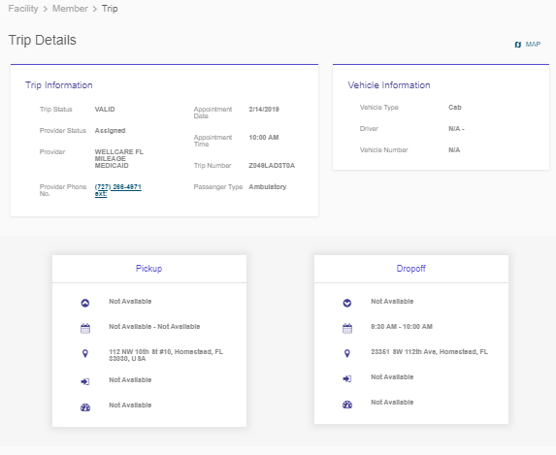
Trip Details
Trip Details will show:
Trip Information
Vehicle Information
Pickup and Drop off information
Map of estimated route

Slide 18
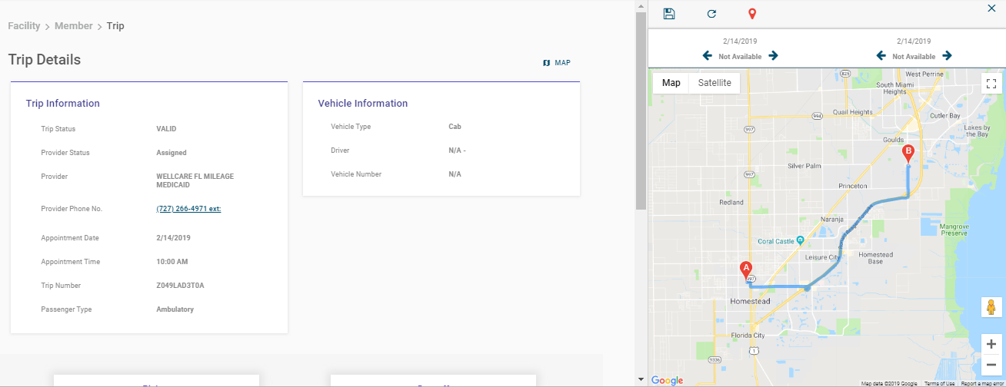
Map View
Clicking the MAP icon will show estimated route details

Slide 19
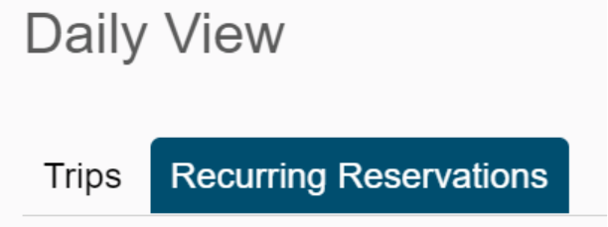
Renew Recurring Reservation
From Daily View click on Recurring Reservations tab

Slide 20
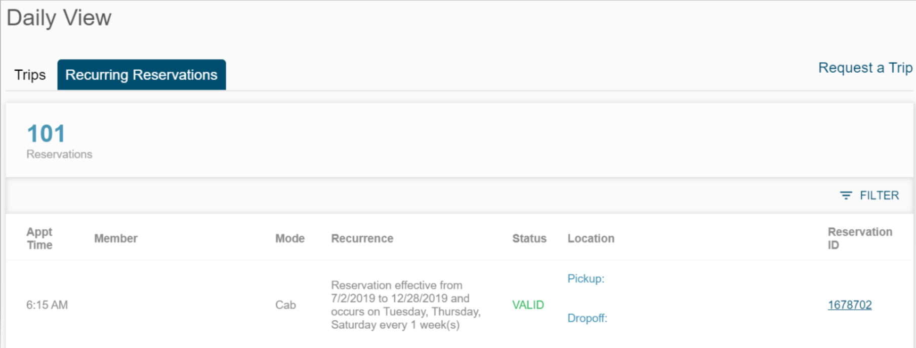
Renew Recurring Reservation
Click on member’s Reservation ID number (trip Status must be VALID)

Slide 21
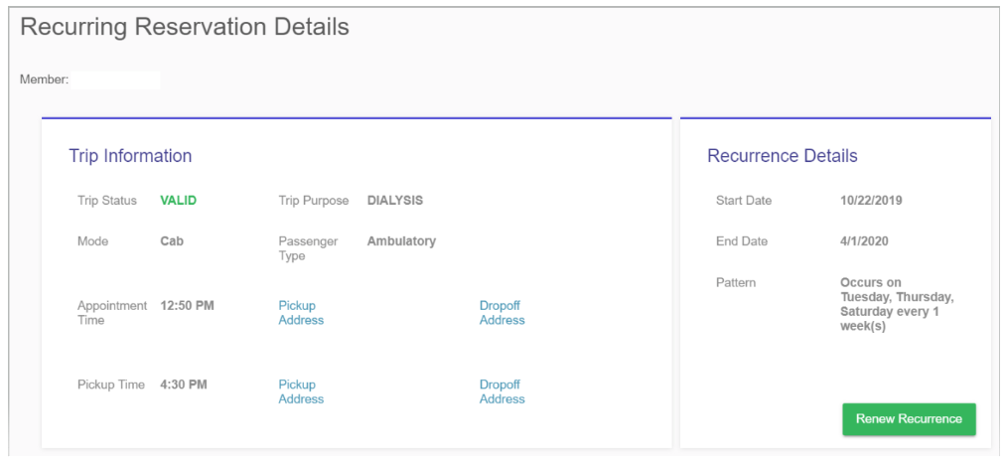
Renew Recurring Reservation
Review Recurring Reservation Details for accuracy
Once confirmed, click on Renew Recurrence
If any details need to change, call MTM or submit a new trip request

Slide 22
Renew Recurring Reservation
Renew Recurring Reservation box will appear
Enter appropriate start and end dates
Check-mark box to verify the recurring reservation and click SUBMIT

Slide 23
Scheduling Trips

Slide 24
Scheduling Single Trips
From the Daily View page, click Request a Trip

Slide 25
Scheduling Single Trips
To schedule a trip, you will navigate through 4 tabs:
Customer Information
Trip Information
Special Needs
Summary

Slide 26
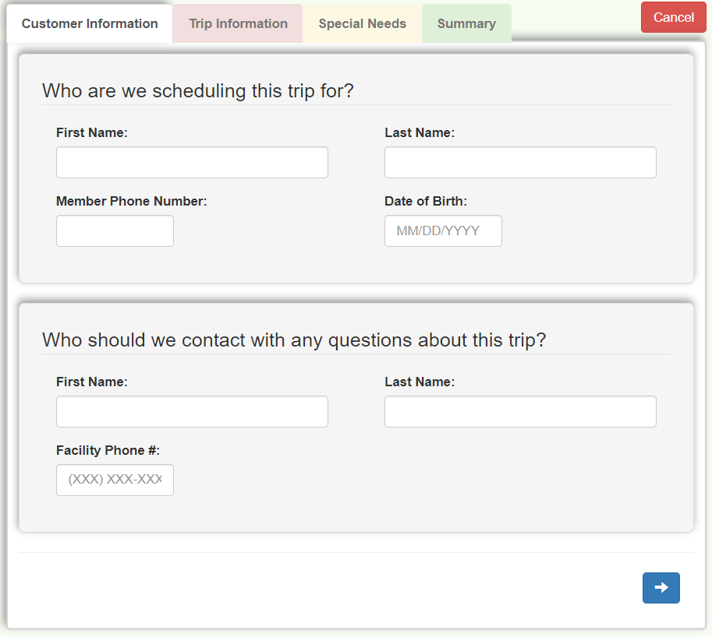
Customer Information
Enter member’s first and last name, phone number and date of birth
Enter first and last name and phone number of individual to contact in case there are questions
Click the forward arrow to move to the Trip Information tab

Slide 27
Trip Information
Enter appointment date and time (military time)
Enter Pick-up Address and Drop-off Address for the ride to appointment
Click Add Return Ride if member will need a return ride home after the appointment
Confirm Pick-Up Address and Drop-off Address are correct in return ride by toggling between the tabs; edit information as needed
Enter a Return Time for return ride
If return time is unknown, check-mark Will Call box and enter an estimated return time

Slide 28
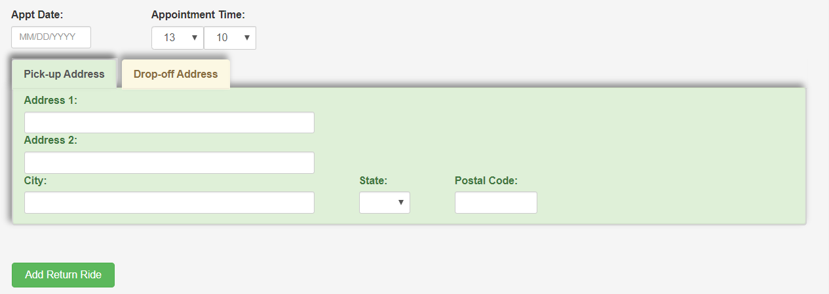
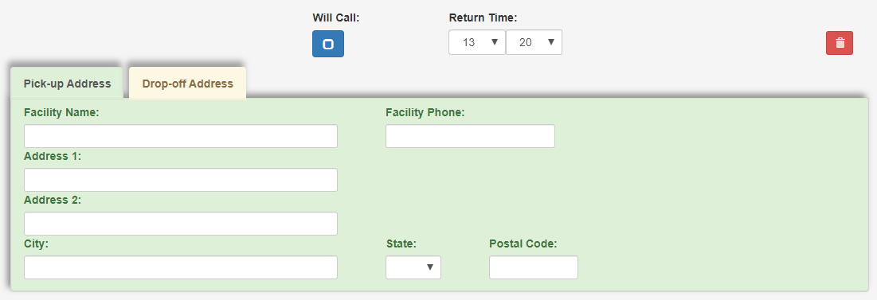
Trip Information
Add screenshot

Slide 29
Scheduling Recurring Trips
Under Trip Information tab select Repeat Trip
Confirm recurring trip by selecting Yes, then OK

Slide 30
Scheduling Recurring Trips
Enter appointment recurrence information and click OK
Start date will automatically default to first date of appointment
Dialysis recurring trips can be set for a maximum of 6 months and all other recurring trips can be set for a maximum of 3 months
Recurring trip information will appear on the trip Summary tab

Slide 31
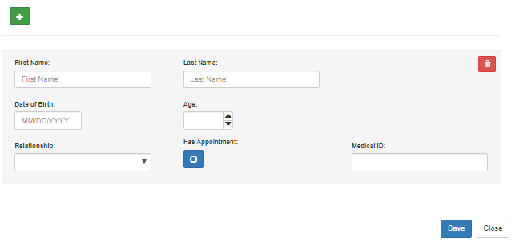
Additional Passengers
Click Add Passenger(s), then click on green plus sign
Enter passenger details and click Save
If passenger has appointment at the same location, check-mark Has Appointment box and enter Medical ID number if it is known

Slide 32
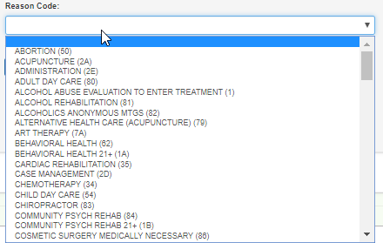
Reason Code
Select trip reason from the drop down menu

Slide 33
Transportation Mode
Select most appropriate transportation mode for member
If Gas Mileage Reimbursement (GMR) is selected, enter payee’s first and last name, mailing address and phone number in the Payee Information box

Slide 34
Preferred Provider
If you have a preferred transportation provider check-mark Preferred Provider Request box and enter name of the provider in Vendor Name field
MTM may not be able to guarantee preferred provider listed unless facility uses a sole-source transportation provider
Vendor Code is not required
Enter pertinent information the transportation provider may need to be aware of in the Notes field
Click the forward arrow to move to the Special Needs tab
Notes:
Centene NE does not offer Ride of Choice but the member may have a Preferred Provider noted on their file.
The note does not guarantee the preferred provider will be selected.

Slide 35
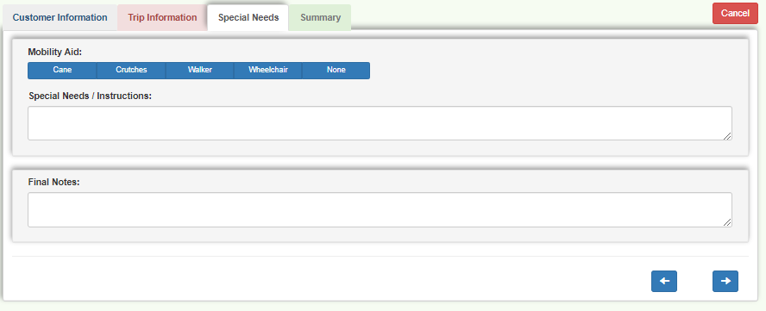
Special Needs
Select a mobility aid if any pertain to member; select None if not applicable
Enter special needs/instructions and any final notes, then click the forward arrow to move to the Summary tab

Slide 36
Special Needs
If Wheelchair is selected as mobility aid, enter all requested details

Slide 37
Summary
Review customer, trip, special needs and notes sections to ensure accuracy
If any corrections are needed, select the appropriate section tab at the top to edit information
Once details are confirmed accurate, click on down arrow at the bottom of the Summary section to submit trip
Trip requests may not immediately appear in Daily View (please do not submit duplicate requests, call MTM with any questions)

Slide 38
Troubleshooting

Slide 39
Troubleshooting
Clear cache or refresh browser if it appears that items are missing or not working properly
Google Chrome is the most efficient option and will provide the best experience
Urgent and short notice trips must be called into MTM
Notes:
MTM is continuously enhancing the facility user experience with new features and functionality; as we continue to improve your online experience.
Please keep these key points in mind that will help ensure optimal usage:
PSC-Again, not sure Facility User, Cache, Short notice needs to be capitalized.
-The top line needs to be bulleted and then there need to be sub-bullets.
-The second bullet needs to be broken apart and made into a couple of bullets.
-Third bullet should be highlighted and centered.

Slide 40
Questions?
Please contact Community Outreach at:
CO-OR@mtm-inc.net

