Slide 1

Comprehensive Behavioral Health Plan
2024 Progress Report
July 1st, 2022 - October 31st, 2023

Slide 2

Land Acknowledgement
We want to respectfully acknowledge the Cow Creek Band of Umpqua Tribe of Indians ("Tribe" or "Cow Creek"), who have stewarded these lands since time immemorial.
We want to further acknowledge the Tribe's deep cultural and spiritual connection to these lands in addition to its entire interest and ancestral areas, which includes more than six million acres located within the Rogue and Umpqua River Watersheds. These lands and the vibrant resources within them have been important since time immemorial and will continue to be a vibrant part of Tribe's cultural identity for generations to come.
We recognize the preexisting and continued sovereignty of the Tribe and thank them for continuing to share their Indigenous knowledge and perspective on how we might work together to manage and care for these shared resources sustainably, with mutually beneficial outcomes.
We commit to engaging in a respectful, meaningful, and successful partnership as we explore shared stewardship of these lands.

Slide 3
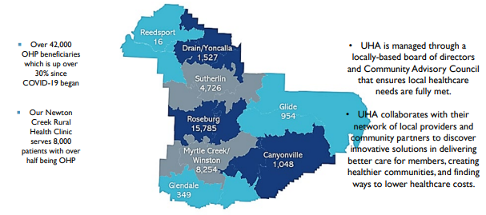
Umpqua Health Alliance is deeply rooted in Douglas County
We have served Oregon Health Plan members for over 27 years

Slide 4
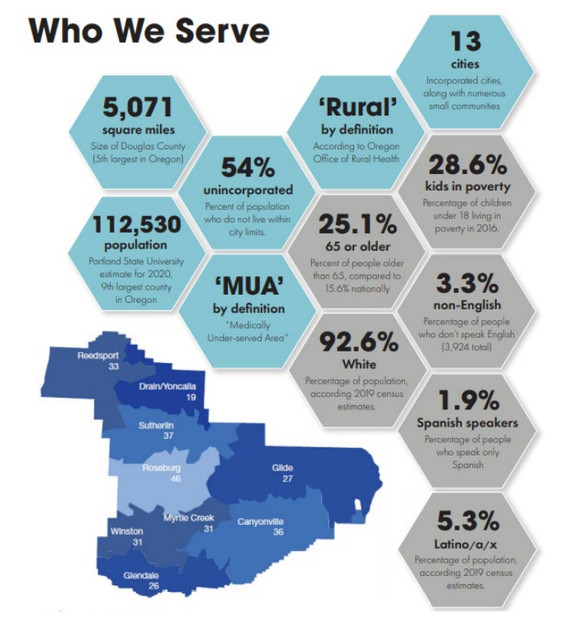
Who we serve, Our Members

Slide 5
Umpqua Health Alliance Overview
Mission
Values
Agreements
Health Equity
Promote and provide high quality, readily accessible healthcare in a patient-centered system of care for those we serve.
Stewardship
Efficiency
Be a Team Player
Integrity
Clear about our purpose before we act
Present and engaged with one another as we work
Real and authentic in our communication
Connected through being kind and caring
Creative and innovative individually and collectively
UHA’s mission works to achieve health equity for all population groups by allocating resources towards designing policies and programs to create greater social justice in health
Accountability

Slide 6
Accountability
Integrity
Efficiency
Stewardship
Be a Team Player
Support and assist your team members. Be available to help and learn from your team. Keep an open mind to feedback and earn trust of staff
Always demonstrate the highest performance and behavior standards. Share responsibility and expect others to be accountable.
Keep your promises, commitments, and confidences. Be honest and straightforward dealing with all issues fairly and consistently.
Demonstrate a proactive approach to problem identification and solutions. Be innovative and solutions oriented, improving processes while reducing costs. Demonstrate appropriate time management skills. Optimize the use of available resources.
Adhere to all state and federal regulations relating to your position including the Health Insurance Portability and Accountability Act (HIPAA), Fraud & Abuse and Occupational Safety and Health Administration (OSHA) laws. Abide by Company policies and procedures at all times.
Our Values

Slide 7
Equity Statement
Umpqua Health Alliance recognizes the importance of treating emotional, psychological, and social well-being with the same care as physical health concerns. Collaboration and integration between physical health and mental/behavioral health agencies improves health outcomes and overall continuity of care. The behavioral health integration team supports the delivery of community-based healthcare; cultivates diversity, equity, and inclusion internally and externally by respecting and valuing all individual’s cultural beliefs and practices, health literacy, preferred languages, and communication needs.
UHA shares the mission of Oregon Health Authority’s Child and Family Behavioral Health (CFBH) unit to incorporate System of Care values and trauma-informed approaches to provide efficient and effective behavioral health services and supports for Oregon's children, youth, young adults, and their families. System of care values include prioritizing the creation of a sustainable community-based continuum of quality care that is individualized, responsive, meaningful, youth guided, family driven, culturally responsive, and evidence based.
We strive to achieve and implement continuous improvements in UHA’s Behavioral Health program by enhancing behavioral health network adequacy and access, supporting delivery system transformation, and the development and implementation of a formal program integrity plan. In 2024, the Behavioral Health Integration Team will identify and reduce gaps in services, decrease inefficiencies, and improve overall member experience.

Slide 8

Equity Statement
UHA is committed to fostering health equity in the communities we serve. We recognize the importance of addressing social determinants of health and acknowledging the unique strengths and assets within our organization to reduce health inequities.
Our health equity statement is as follows: “UHA’s mission works to achieve health equity for all population groups by allocating resources towards designing policies and programs to create greater social justice in health.”

Slide 9
Equity Strengths & Measurements
UHA understands the pursuit of equity is an ongoing process and therefore has allocated resources to continue this work. The Director of Health Equity, Diversity, and Inclusion who serves as the Health Equity Administrator is responsible for tracking progress in this area through the annual Health Equity Plan submission to the OHA, as well as in UHA’s internal Culturally and Linguistically Appropriate Services (CLAS) workgroup and through the NCQA Health Equity Accreditation process.
In each of these areas, UHA evaluates data to identify disparities related to race and ethnicity, language, disability, sexual orientation, and gender identity. This data is monitored at the Quality Improvement Committee (QIC), and relevant subcommittees, and interventions are identified and implemented based on these findings. As part of the annual evaluation of the CLAS and Quality work plan, UHA evaluates the effectiveness of these interventions and acts based on these analyses. This information is shared with the QIC, board, and Community Advisory Committee (CAC) to ensure effective communication to and feedback from all relevant stakeholders.

Slide 10



Our commitment to fostering health equity is woven throughout this Comprehensive Behavioral Health Plan in our 3 priority areas:
Improve involvement in community housing initiatives to improve housing accessibility, affordability, and availability for members with Behavioral Health concerns
Enhance the Behavioral Health service array across the continuum of care and increase community capacity to provide treatment at higher levels of care.
Increase service availability through behavioral health workforce development by engaging community stakeholders to create, promote, and support educational & training initiatives.
Housing
Workforce Development
Behavioral Health Treatment

Slide 11
IMPROVE INVOLVEMENT IN COMMUNITY HOUSING INITIATIVES TO IMPROVE ACCESSIBILITY, AFFORDABILITY, AND AVAILABILITY FOR MEMBERS WITH BEHAVIORAL HEALTH CONCERNS.
Priority area 1

Slide 12
IMPROVE INVOLVEMENT IN COMMUNITY HOUSING INITIATIVES TO IMPROVE ACCESSIBILITY, AFFORDABILITY, AND AVAILABILITY FOR MEMBERS WITH BEHAVIORAL HEALTH CONCERNS.
Priority area 1
Intervention 1: Convene a recurring meeting with key organizations focused on housing capacity development for the Behavioral Health population, not less than Quarterly
Intervention 3: Open a local Navigation Center within 2 years
Intervention 4: Community- Level Infrastructure Housing Investments
Intervention 2: Establish a local homeless commission to address unhoused population in City of Roseburg​
Complete
Complete
Complete

Slide 13

Intervention 1: CONVENE A RECURRING MEETING WITH KEY ORGANIZATIONS FOCUSED ON HOUSING CAPACITY DEVELOPMENT FOR THE BEHAVIORAL HEALTH POPULATION, NOT LESS THAN Quarterly.
UHA and Adapt meet monthly to discuss behavioral health capacity development, which includes housing and clinical programs.
UHA tracks capacity development through reports from the monthly Homeless Transition Action Group (HTAG), LPSCC and the LPSCC Behavioral Health & Housing Subcommittee.
UHA established a Behavioral Health Committee in April 2023, a recurring monthly meeting including contracted provider partners.
  The Behavioral Health Committee will begin discussing housing capacity development, at least once quarterly in 2024.

Slide 14
Intervention 2: ESTABLISH A LOCAL HOMELESS COMMISSION TO ADDRESS UNHOUSED POPULATION IN CITY OF ROSEBURG​
The local homeless commission meets monthly, with local community leaders including UHA's CEO.
UHA is actively engaged in the monthly LPSCC Behavioral Health, & Housing Subcommittee.
UHA serves on the Homeless Transitions Action Group (HTAG) as an advisor to our community partners including Adapt Integrated Health Care, HADCO, Oxford Homes, Cow Creek Band of Umpqua Tribe of Indians, and UCAN. ​
Intervention: Complete.
Priority area 1: IMPROVE INVOLVEMENT IN COMMUNITY HOUSING INITIATIVES TO IMPROVE ACCESSIBILITY, AFFORDABILITY, AND AVAILABILITY FOR MEMBERS WITH BEHAVIORAL HEALTH CONCERNS

Slide 15
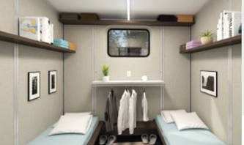
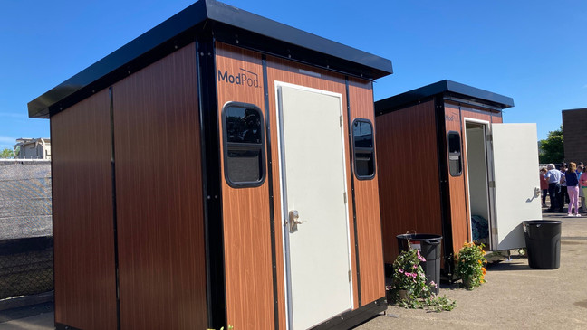

Intervention 3: Open a local navigation center within 2 years
UHA provided $200,000 to the Gary Leif Navigation Center. The center operates as a low barrier shelter/housing first option and directs community members to needed resources and services.
Phase 1 - Opened in June 2022, with 10 individual pallet shelters, the facility has accommodated 38 guests along with 6 cats and 5 dogs. The center has achieved a 76% success rate in facilitating transition to longer term housing options.
Phase 2 - Completed in September 2023 with the addition of 30 interior congregate shelter beds.
Fully open and operational. Intervention complete.
Priority area 1: IMPROVE INVOLVEMENT IN COMMUNITY HOUSING INITIATIVES TO IMPROVE ACCESSIBILITY, AFFORDABILITY, AND AVAILABILITY FOR MEMBERS WITH BEHAVIORAL HEALTH CONCERNS

Slide 16
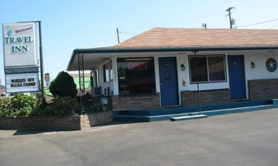
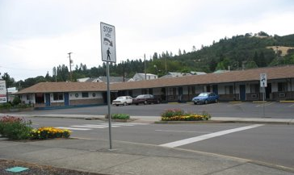
Intervention 4: UHA’s Investment in COMMUNITY Housing developments
UHA provided $100,000 to Adapt Integrated Health Care to increase transitional housing resources for individuals with substance use disorder needs
  Funds were used for the remodel and development of “The Lodge,” a 12-unit hotel which will become a transitional housing resource for individuals that have substance use disorder needs ​
"511 Stephens" is a 52-bed hotel that is undergoing renovation. This behavioral health housing will have rooms set aside for short and long-term needs as well as assisting those returning from the state hospital.
Both hotels are staffed with peers and the goal is to engage people experiencing substance use disorders and mental health needs. Peers will work with the tenants to identify needs and goals, make the connections to allow the tenant to engage in the services identified, and work to maintain continued progress on these services.
Priority area 1: IMPROVE INVOLVEMENT IN COMMUNITY HOUSING INITIATIVES TO IMPROVE ACCESSIBILITY, AFFORDABILITY, AND AVAILABILITY FOR MEMBERS WITH BEHAVIORAL HEALTH CONCERNS

Slide 17

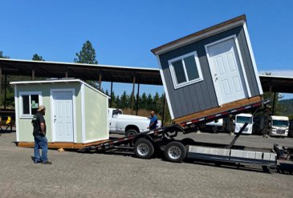
Intervention 4: COMMUNITY LEVEL INFRASTRUCTURE HOUSING INVESTMENTS
Hastings Village & Umpqua Heart
In 2023, Umpqua Health Alliance provided $100,000 to add water, sewer and electricity on the Hastings Village property.
UHA’s Community Engagement Manager sits on the board of Umpqua Heart which oversees Hastings Village.
“Hastings Village is more than a homeless camp, it’s warmth during winter, an extended family to care about, a community to lean on in times of need”
~ Resident of Hastings Village
Priority area 1: IMPROVE INVOLVEMENT IN COMMUNITY HOUSING INITIATIVES TO IMPROVE ACCESSIBILITY, AFFORDABILITY, AND AVAILABILITY FOR MEMBERS WITH BEHAVIORAL HEALTH CONCERNS

Slide 18

Intervention 4: COMMUNITY LEVEL INFRASTRUCTURE HOUSING INVESTMENTS
Safe space for LGBTQIA2S+ & Houseless Youth
UHA contributed $56,000 to Tasha's House
Tasha’s House supports the LGBTQIA+ community of Douglas County by providing a drop-in youth center, a meeting space for community groups, a clothing exchange closet with gender-affirming items, and a temporary shelter for unhoused youth.
When school is over for the day, not all children have a comfortable environment to come home to. Tasha's House offers a warm place to stay, study, play, eat and relax while accessing other services and seeking housing solutions.
Priority area 1: IMPROVE INVOLVEMENT IN COMMUNITY HOUSING INITIATIVES TO IMPROVE ACCESSIBILITY, AFFORDABILITY, AND AVAILABILITY FOR MEMBERS WITH BEHAVIORAL HEALTH CONCERNS

Slide 19
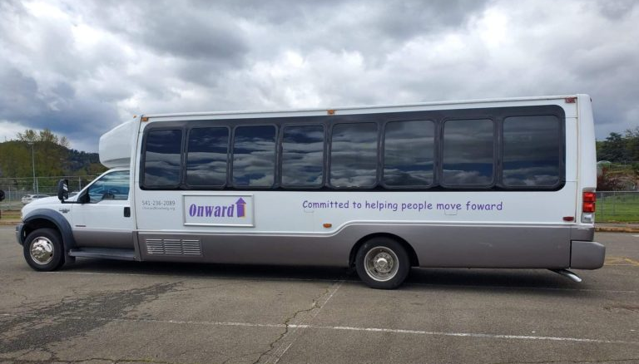
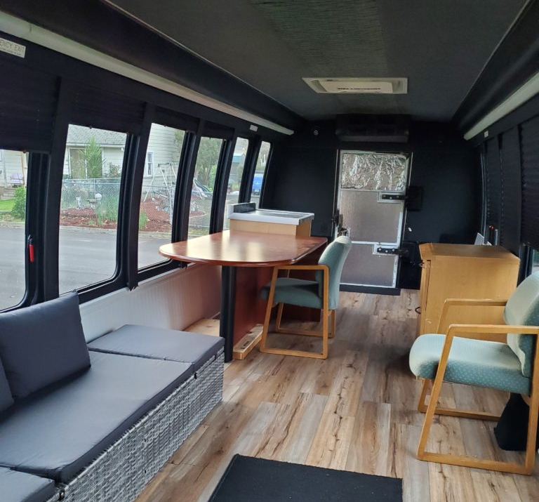
INTERVENTION 4: COMMUNITY LEVEL INFRASTRUCTURE HOUSING
INVESTMENTs
UHA contributed $16,800 to Onward Roseburg
Onward Roseburg uses outreach, advocacy, and referrals to empower people experiencing homelessness and reduce common barriers that prevent personal development.
With their mobile office, Onward meets people where they are in their journey and comes alongside folks to help obtain ID's, email addresses, order birth certificates, apply for Social Security and/or Disability, and fill out housing applications
Priority area 1: IMPROVE INVOLVEMENT IN COMMUNITY HOUSING INITIATIVES TO IMPROVE ACCESSIBILITY, AFFORDABILITY, AND AVAILABILITY FOR MEMBERS WITH BEHAVIORAL HEALTH CONCERNS

Slide 20

Intervention 4: UHA supports housing through Flexible spending
UHA provides temporary housing (i.e. hotel stays) to support folks who are homeless and have medical issues that need a stable environment.
  Post hospitalization or ER visit
  Outpatient wound care or infusion therapies
  Oxford House (sober living) support for SUD treatment
UHA provides financial support to individuals with emergent needs, such as: assistance with rent, utilities, and renovation(s) to enable members to remain in their housing.
UHA provides care coordination to connect members with wrap around services that foster permanent independence.
Priority area 1: IMPROVE INVOLVEMENT IN COMMUNITY HOUSING INITIATIVES TO IMPROVE ACCESSIBILITY, AFFORDABILITY, AND AVAILABILITY FOR MEMBERS WITH BEHAVIORAL HEALTH CONCERNS

Slide 21
INTERVENTION 4:
COMMUNITY LEVEL INFRASTRUCTURE HOUSING INVESTMENTS
UHA’s Flexible spending expenditures on housing
Oxford Housing
Rent Assistance
Mortgage Assistance
Appliances
Temporary Housing
Housing Improvements
Pest Control
RV Repair
$1,007,023.49
HRS Housing Expenditures
from July 01, 2022 - November 30, 2023
Priority area 1: IMPROVE INVOLVEMENT IN COMMUNITY HOUSING INITIATIVES TO IMPROVE ACCESSIBILITY, AFFORDABILITY, AND AVAILABILITY FOR MEMBERS WITH BEHAVIORAL HEALTH CONCERNS

Slide 22

INTERVENTION 4: COMMUNITY LEVEL INFRASTRUCTURE HOUSING gap
Gap: limited number of family-centered transitional housing resources
Roseburg has a men's shelter and a women's shelter. Unhoused families are often faced with the difficult choice of splitting up the family or living on the street. Gary Leif Navigation Center is starting to add space for unhoused families and Adapt Integrated Health Care has Hillside Terrace
Hillside Terrace transitional housing provides an opportunity for people in the early stages of recovery and their children to transition back into daily life at a slow and gradual pace. The goal of this transitional housing is to safely reunite children with their families by providing the support and guidance needed to restore family health, stability and self-sufficiency. This housing offers safe, alcohol and drug-free housing, along with treatment for substance use and co-occurring disorders in a structured and supervised environment for parents and their children. Residents have full access to Adapt’s treatment programs and services to support continuity of care, aftercare and sustained health and recovery.
Only 50% of the 8 units are occupied
Priority area 1: IMPROVE INVOLVEMENT IN COMMUNITY HOUSING INITIATIVES TO IMPROVE ACCESSIBILITY, AFFORDABILITY, AND AVAILABILITY FOR MEMBERS WITH BEHAVIORAL HEALTH CONCERNS

Slide 23
Community Engagement Activities
UHA Community Health Workers actively engage with the community and offer UHA Care Coordination Services during the following events:
Every Monday at the Roseburg Dream Center from 10AM-12PM
Every Tuesday at the Navigation Center from 10AM-12PM,
The first Thursday of every month at ODHS from 10am-12pm
The third Friday of every month at Hastings Village from 1:30pm-3pm
The annual PIT count.
Community Health Assessment Focus Groups, Healthy Equity & Housing
6 consumer voice focus groups were held throughout 2023 and one was specifically designed for people experiencing houselessness.
One listening session was held with our Hispanic/Latino/a Spanish Speaking Community
Participants noted the stress caused by lack of affordable housing, especially for young adults looking to live independently.
The Umpqua Health Innovation Conference was open to all, held on 10/02/23 with a focus on Health Equity
Priority area 1: IMPROVE INVOLVEMENT IN COMMUNITY HOUSING INITIATIVES TO IMPROVE ACCESSIBILITY, AFFORDABILITY, AND AVAILABILITY FOR MEMBERS WITH BEHAVIORAL HEALTH CONCERNS

Slide 24
Equitable access to Community & wellness spaces
Umpqua Health’s vision to affect health upstream and eliminate health disparities is the foundation for supporting programs and services that create equal opportunities for Douglas County residents to lead a healthy lifestyle where they live, work, and play. Throughout 2022 and 2023 Umpqua Health supported several healthy lifestyle initiatives including:
The Douglas County 2023 Pride Fest, an event to celebrate members of the LGBTQIA2S+ population and their allies. Additionally, UHA provides resources to the Umpqua Valley Rainbow Collective for community building and support systems for LGBTQIA2S+ community members.
The Yoncalla School and Community Playground Wellness Path, in partnership with the Yoncalla School District. The trail is part of the playscape project and will include planned exercise and mindfulness stations throughout to encourage students and community members to focus on their well-being.
Community Gardening with NeighborWorks Umpqua. The partnership provided residents in low-income housing supplies and support for porch gardens and community gardens with in-ground and raised garden beds.
Priority area 1: IMPROVE INVOLVEMENT IN COMMUNITY HOUSING INITIATIVES TO IMPROVE ACCESSIBILITY, AFFORDABILITY, AND AVAILABILITY FOR MEMBERS WITH BEHAVIORAL HEALTH CONCERNS

Slide 25
Priority Area I: Commentary
Intervention 1: Strategic involvement with community partners, focusing on housing capacity developments
Intervention 2: Increase investment in infrastructure development focused on housing for individuals with behavioral health needs
Intervention 3: Increase youth and family-centered housing resources
Increase the number of families sheltered through the Gary Leif Navigation Center by 10% by the end of Q4 in 2024
Increase the capacity of Adapts Rodeway Project for individuals experiencing behavioral health concerns and in need of transitional housing, by adding 10 beds by the end of 2024.
Increase family occupancy of Hillside Terrace in 2024 from 50% to 75% by the end of Q4.
UHA will participate in the annual Point in Time Houseless count in January 2024.
Implement quarterly tracking and monitoring of the number of members with behavioral health needs receiving Housing-Related HRS. Looking to identify trends and opportunities for improvement in housing support services.
Open a supportive housing program for transitional aged youth, 18-24, by the end of 2025
Attend all the Homeless Transition Action Group (HTAG) meetings and the LPSCC Behavioral Health & Housing Subcommittee Meetings in 2024 to increase strategic involvement with community partners.
Increase referrals to Neighborworks Umpqua's Housing Stability Program by 3% by the end of Q4 2024. This program focuses on enhancing the skills, knowledge, and abilities of low-income and unhoused individuals to secure housing and attain stability and success.
Increase the number of members with substance use disorders provided transitional housing through Adapts Lodge by at least 2% in 2024.
Gather information and updates during these meetings on housing capacity developments including urban campground development and promote the Share Application for increased potential funded housing opportunities.
Socialize housing capacity development updates with the Behavioral Health Committee, at least once quarterly throughout 2024.
GOALS FOR NEXT YEAR
Many of the interventions set within priority area 1 were achieved between 2022-2023, these completed interventions have been re-evaluated and updated to reflect ongoing population-specific need
Priority area 1: IMPROVE INVOLVEMENT IN COMMUNITY HOUSING INITIATIVES TO IMPROVE ACCESSIBILITY, AFFORDABILITY, AND AVAILABILITY FOR MEMBERS WITH BEHAVIORAL HEALTH CONCERNS

Slide 26
Upcoming Dates & Decisions
In 2024
By the end of Quarter 1
By the end of Quarter 2
UHA will host a webinar about Community Capacity Building Funds to promote housing development.
UHA will host a grant education webinar to help community-based organizations learn how to apply for UHA grant funds (including the housing requirement of SHARE funds).
By the end of Quarter 3
By the end of Quarter 4
Adapt Integrated Health Care will finish construction on the Rodeway Behavioral Health Project with 10 rooms dedicated to UHA members experiencing behavioral health concerns.
Conduct survey on Behavioral Health Housing needs
UHA will develop a Memorandum of Understanding with Adapt Integrated Health Care to set aside 10 rooms of their 52-room hotel for UHA Members with behavioral health needs.
Host annual Umpqua Innovation Conference to highlight the CHP and SHARE Housing Initiatives.
CHIP funding will be announced.
Priority area 1: IMPROVE INVOLVEMENT IN COMMUNITY HOUSING INITIATIVES TO IMPROVE ACCESSIBILITY, AFFORDABILITY, AND AVAILABILITY FOR MEMBERS WITH BEHAVIORAL HEALTH CONCERNS

Slide 27
Increase continuum of care and community capacity to provide treatment at higher levels of care.
Priority area 2

Slide 28
INCREASE CONTINUUM OF CARE AND COMMUNITY CAPACITY TO PROVIDE TREATMENT AT HIGHER LEVELS OF CARE.
Priority area 2
Intervention 1: Open adult inpatient psychiatric unit at Mercy Medical Center within one year
Intervention 2: Open Sobering Center within one year
Intervention 3: Develop and implement VBP plan to incentivize providers in reducing inappropriate utilization of emergency services and higher levels of care by Q2 2024
Intervention 4: Double IIBHT capacity for youth/adolescents from 10 to 20 within one year
Intervention 5: Develop and distribute infographics and resource/guides on pathways to treatment and available services/ programs by Q4 2022
Complete
Complete
Complete
Complete

Slide 29
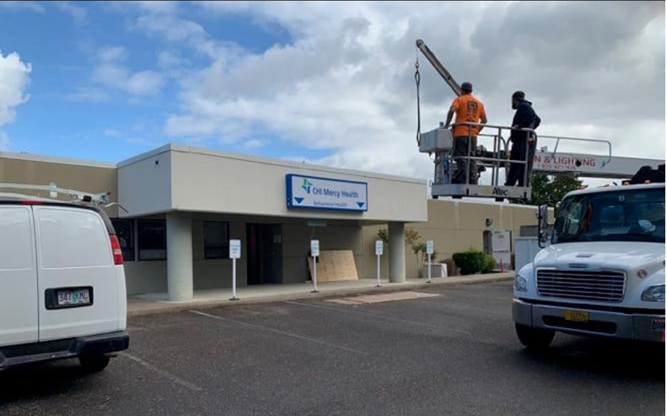
Intervention 1: Open adult inpatient psychiatric unit at Mercy Medical Center within one year
Reduce emergency department readmissions for individuals experiencing a behavioral health crisis
The opening of Mercy’s adult inpatient psychiatric unit has been significantly delayed due to construction supplier challenges, coding and licensing barriers, and recruitment limitations amidst a behavioral health workforce shortage.
Adult Behavioral Health Unit (BHU) will be located on the Mercy Medical Center campus and will provide 24-hour care and emergent services for members with behavioral health needs
  Slated to open January 29, 2024.
  12 double occupancy rooms; 24 beds
Priority area 2: Increase continuum of care and community capacity to provide treatment at higher levels of care.

Slide 30
Intervention 2: Open Sobering Center within one year
Phase 1:
Sobering Center opened August 2021
Phase 2:
Crisis Resolution Rooms have been in use since August 2023
Phase 3:
Adapt's Sobering Center diverts individuals from jail and the emergency department by providing a safe and supervised space to sober up.
This center works collaboratively with teams including Mobile Crisis, Crossroads Residential Treatment, the Assertive Community Treatment Team, Mobile Crisis Team and Detox and Outpatient Teams.
A double-unit structure that provides temporary lodging to individuals experiencing a behavioral health crisis for up to 23 hours
Infrastructure was developed through the support of IMPACTs grant funding from the Criminal Justice Commission (CJC)
Monitor Adapt’s Mobile Crisis team staffing
Increase Mobile Crisis Response and Stabilization Services in 2024
Expanded from 2 FTE to 8 FTE in 2023
Priority area 2: Increase continuum of care and community capacity to provide treatment at higher levels of care.

Slide 31


Intervention 3: Develop and implement value-based payment (VBP) plan to incentivize providers in reducing inappropriate utilization of emergency services and higher levels of care by Q2 2024.
Improve provider management of inappropriate ED utilization
Implement VBP Metric Across Provider Contracts
Address Health Equity in Emergency Department Utilization for
Program targets involve reducing ER return rates to 20.26% (currently at 20.8%) and reaching or surpassing the 17.33% substance use disorder treatment start rate by 2023, which currently stands at 20.3%.
UHA created the Member Attribution Cost Summary (MACS) VBP plan in 2019, The objective is to increase the quality of care due to increased communication and care coordination between PCP, specialists, and facilities regarding the management of member care.
The MACS program curbed inappropriate ER visits; resulting in a total of $25M risk pool payments across 79 vendors across 22 clinics for 2022.
Patient costs are monitored and managed effectively by the PCPs, aiming to remain below 87% of collected premiums. Overshooting the target, can impact other providers involved in the patients’ care.
Preliminary results from 2023 show involvement across 22 clinics
Incentivize provider reporting of REAL+D and SDOH.
Provide training to network providers on cultural responsiveness and implicit bias
Enhance staff comprehension of diverse cultures and backgrounds and improve cultural competency
4- year implementation plan uses an incremental approach of 25%, 50%, 75%, and ending at 100% risk to their withholding. .
Improve management of members with mild to moderate mental illness and/or substance use disorders within the primary care setting
Priority area 2: Increase continuum of care and community capacity to provide treatment at higher levels of care.

Slide 32
Intervention 4: Increase local IIBHT Program Capacity
Double IIBHT capacity for youth and adolescents from 10 to 20 within one year
Intervention Complete
2 IIBHT Program Clinicians Recruited in 2023 to increase program capacity.
Increased youth participation in IIBHT by 46.2% for 2023.
UHA was the first CCO in Oregon to successfully implement IIBHT to address gaps in the children’s mental health service array.
Priority area 2: Increase continuum of care and community capacity to provide treatment at higher levels of care.

Slide 33
Intervention 5: Develop and distribute infographics and resource guides on pathways to treatment and available services/programs
CM Referral Form
Care Coordination Program Services Information
Certificate of Need Form
IIBHT Program Flyer
IIBHT Referral Form
Disorder Eating Consultation and a TIP Sheet
Peer Delivered Services Flyer
Community Health Worker Flyer
Hepatitis C – Education, Treatment, and Resources
New Day Program Flyer – For pregnant mothers with substance use or mental health disorders
New Beginnings Program Flyer – Children 0-5 program that works with the child and their families to offer supports and resources.
Specialty & Integrated Behavioral Health Asset Map for Young Children Birth to Five (0-5)
updated in 2023
Infographics Created
Resource Guides Created
12
1
Intervention: Complete
Priority Area 2: Increase continuum of care and community capacity to provide treatment at higher levels of care.

Slide 34
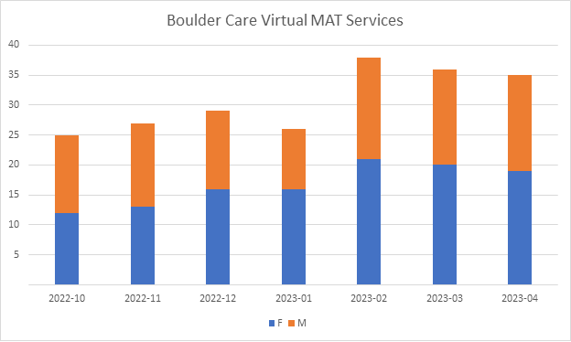
Intervention 2: Increasing access to outpatient substance use disorder treatment to prevent the need for higher levels of care
Boulder Care – Telehealth SUD services
Since contracting in October 2022, UHA members have been steadily increasing as depicted below:
Newly contracted in October 2022
Providing medically assisted treatment (MAT) services
Telehealth services in an all-inclusive monthly bundled rate.
Priority Area 2: Increase continuum of care and community capacity to provide treatment at higher levels of care.

Slide 35

Intervention 2: Increasing access to outpatient substance use disorder treatment to prevent the need for higher levels of care
New Contingency Management Program Development
In 2023, a new Contingency Management Program was opened at the Adapt Opioid Treatment Program (OTP) in Roseburg
Incentivizing Treatment Adherence
OHP clients who meet various treatment goals will receive incentives to reinforce the positive behavior.
The programs' goal is to increase daily dosing and counseling adherence by 15% compared to yearly total patient missed days and absentee reports in 2022.
UHA provided $6,000 in April 2023 to support a rewards for the new Contingency Management treatment program.
In October of 2023:
UHA’s Behavioral Health Care Management Team Participated in Annual Community Event Focused on Overdose Prevention
Priority Area 2: Increase continuum of care and community capacity to provide treatment at higher levels of care.

Slide 36

Intervention 2:
Increasing access to residential substance use disorder treatment
In September of 2022, UHA expanded contracted services with Willamette Family Treatment Services
WFT offers separate campuses for residential treatment that includes a women’s campus that allows for clients to bring their children and allows for longer stays . They work closely with DHS custody cases to reunite parents with their children.
We negotiated quality metrics into their agreement focused on:
Initiation and engagement of substance use disorder treatment
Reducing ED utilization for SUD
Priority Area 2: Increase continuum of care and community capacity to provide treatment at higher levels of care.

Slide 37

Community engagement activities
What we heard from listening to parents of Hispanic/Latino/a Spanish Speaking Children in August 2023:
Latinx is an educational term that isn't culturally accepted
There is lack of attunement to cultural norms
Culturally specific educational resources are needed
Families need help navigating resources & referrals
Medical interpreters would be more beneficial than translation services
Mistrust of providers and their experience in interactions with providers generates feelings around shame
Screenings tools & forms are not offered In Spanish
Priority Area 2: Increase continuum of care and community capacity to provide treatment at higher levels of care.

Slide 38
Priority Area II: Commentary
Intervention 1: Decrease inappropriate use of emergency departments for individuals with behavioral health needs
Intervention 2: Increase array of behavioral health services available to treat individuals in need of higher levels of care
Intervention 3: Incentivize providers to improve quality of care and responsiveness to acute, urgent, and emergent behavioral health needs
Intervention 5: Continue to expand collection of infographics and resource/guides on pathways to treatment and available services/programs for 2024
Intervention 4: Increase capacity of youth-serving programs to offer higher intensity outpatient treatment services
Reduce emergency department readmissions rate for individuals with behavioral health conditions by at least 10% in 2024.
Monitor use of ED Diversion metrics in provider contracts each quarter in 2024.
Track the quality-of-care performance in all contracted practices with ED-related quality metrics, for a 10% improvement.
Increase the number of youth receiving IIBHT by 10 by the end of Quarter 4, 2024.
Monitor the number of members utilizing SUD residential and withdrawal management services with a goal to increase their utilization by 10% compared to 2023.
Increase the number of members served at the Sobering Center by at least 10%.
Record the number of SUD affected members serviced by the Recovery Lodge and increase participation by at least 10% compared to 2023.
Offer behavioral health providers utilization of UHA’s analytics software, aiming to improve treatment outcomes, in 2024.
Update the social-emotional asset map for children aged birth to five, to include community-based organizations.
Publish 8 comprehensive infographics detailing available services and pathways to increase user understanding and engagement.
Implement an incentive program that providers reporting REAL+D and SDOH data, increasing reporting by 20% in 2024.
Increase number of members served by the mobile crisis response team by 20%
GOALS FOR NEXT YEAR
Between 2022-2023, most interventions set in priority area 2 have been achieved. These interventions have been re-evaluated and updated to reflect ongoing population-specific needs.
Priority Area 2: Increase continuum of care and community capacity to provide treatment at higher levels of care.

Slide 39

community meeting asset map insights
Douglas County has assets that are amazing. The community partners are committed to the social-emotional health and wellbeing of young children.
In 2022 we identified the need for more CCO in-network providers as we learned that there were 9 organizations with 22 providers with capacity to serve 47 young children, birth to five.
In 2023 we've contracted with 16 organizations with 34 specialty behavioral health providers and 6 integrated behavioral health providers within PCPCH with capacity to see children same day.
Priority Area 2: Increase continuum of care and community capacity to provide treatment at higher levels of care.

Slide 40
Future Goals, Upcoming Dates & Decisions
By the end of Quarter 1
Conduct process improvement on youth referral management process(es) to increase enrollment in Wraparound and IIBHT programs
By the end of Quarter 2
Development of a comprehensive behavioral health community resource guide available on UHA's website
By the end of Quarter 3
Adapt Integrated Health Care will add an additional IIBHT Therapist to increase program capacity
By the end of Quarter 4
Adapt Integrated Health Care will have MRSS for youth fully staffed
Monitor members utilizing SUD residential and withdrawal management services
Young Children, ages birth-five social-emotional asset map will be updated with community-based organizations
UHA will Implement Quarterly Monitoring
Adapt Integrated Health Care Campus Expansion
Develop and publish culturally specific behavioral health educational resources
Utilization of Withdrawal Management (Detox) and Residential Substance Use Disorder Treatment Services
Emergency Department Readmissions for individuals with behavioral health conditions
Track the number of members served at the Sobering Center
Monitor Mobile Crisis utilization.
Establish collaborative quarterly meeting with MRSS, IIBHT and Wraparound program leadership to decrease youth/adolescent Emergency Department boarding
Track the number served by the Recovery Lodge
Monitor utilization of IIBHT
Priority Area 2: Increase continuum of care and community capacity to provide treatment at higher levels of care.

Slide 41
Increase availability of behavioral health services through workforce development by engaging community stakeholders to create, promote, and support education & training initiatives.
Priority area 3

Slide 42
Increase behavioral health service availability through workforce development
Priority area 3
Intervention 1: Create local training pathways for traditional health workers in partnership with community organizations to increase THW workforce
Intervention 4: Require REALD data to be collected on all UHA credentialed/ contracted providers by Q4 2023 to accurately assess provider to resident demographics
Intervention 2: Develop and offer (3) Eating Disorder trainings for Douglas County community by Q2 2022
Intervention 6: Forge partnership with at least one higher education academic institution to develop & promote distance learning to increase local behavioral health workforce
Intervention 5: Form Southwest Oregon Collaborative impact team by Q4 2022
Intervention 3: Fund credentialing of at least (5) local behavioral health providers through The International Association Of Eating Disorders Professionals (IADEP) by Q4 2023
Completed and updated for 2024
Completed and updated for 2024
Revised in Progress Report 1
Revised for 2024
Removed in Progress Report 1
Revised and updated to Intervention 5 for 2024
Priority Area 3: Increase behavioral health service availability through workforce development

Slide 43
Intervention 1: Create local training pathways for traditional health workers in partnership with community organizations to increase THW workforce by 15% by 2024
Develop Local Workforce Pipeline for Peer Support Services through Chadwick Clubhouse
Peer support provided to over 100 members in 2023
Daily clubhouse attendance average of 9 members
Incentivize Recruitment of THW across UHA Provider Network
21 Behavioral Health Peers Contracted
749 Members received THW services in 2023
Create low barrier access to Peer Delivered Services through Adapt’s Behavioral Health Resource Network (BHRN) grant
Conduct Quarterly Evaluation of Peer Delivered Service Utilization among members with behavioral health needs
THW dashboard developed & implemented in 2022
Barriers: Training, credentialing, and billing requirements limit peer delivered service expansion beyond organizations with a Certificate of Approval (COA)
10 BHRN grant peers recruited between 2022-2023
Began monitoring THW utilization through the dashboard in 2023
Intervention Complete
Priority Area 3: Increase behavioral health service availability through workforce development

Slide 44
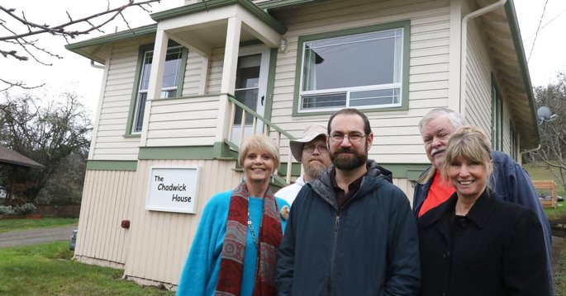
Intervention 1: Improving access to traditional Health Workers through the Chadwick Clubhouse
Breaking Isolation: Wellness Rising
Chadwick follows the community mental health service clubhouse model and offers services to members including education attainment, workforce development, and a place for individuals with mental health diagnosis to form social bonds.
In 2023, UHA partnered with Chadwick Clubhouse by providing $25,000 in CHIP funding to support overall Clubhouse operations.
More than 80% of Clubhouse members had no emergency department visits, or at least a 10% decrease in visits since becoming members.
Photo courtesy of the News Review
Intervention Complete
Priority Area 3: Increase behavioral health service availability through workforce development

Slide 45

Intervention 2 : Develop and offer (3) Eating Disorder trainings for Douglas County community by Q2 2022
Intervention Completed in Progress Report 1
Revised Intervention:
Enhance provider capacity to treat eating disorders through partnership with Willamette Nutrition Source​
4 providers contracted for on-demand eating disorder consultation from 2022-2023
Marketing materials created and socialized across Provider Network
Begin monitoring provider network utilization of eating disorder consultation in 2024
Priority Area 3: Increase behavioral health service availability through workforce development

Slide 46

Intervention 3: Fund credentialing of at least (5) local behavioral health providers through The International Association Of Eating Disorders Professionals (IADEP) by Q4 2023
Intervention Removed in Progress Report 1
Revised Intervention:
Increase local training and education opportunities to expand access to evidence-based treatment modalities
1 Training offered to UHA's provider network on Culturally Competent Substance Use Disorder Care
Increase contracted provider enrollment in Quarterly ECHO Network Programs
1 CLAS training provided to all internal UHA staff and distributed to contracted provider network
Priority Area 3: Increase behavioral health service availability through workforce development

Slide 47
Intervention 4: Require REALD data to be collected on all UHA credentialed/ contracted providers by Q4 2023 to accurately assess provider to member demographics
Provider contracting application will require REALD data from all UHA credentialed/ contracted providers
Provider contracting application revised and digitized in 2023
Improve accuracy of provider demographic data published in UHA provider directory.
Developed scholarship program to increase number of contracted providers that are OHA Certified/ Qualified interpreters
Evaluate panel responsiveness by comparing contracted behavioral health provider demographics with membership demographic information by Q4 2024
Develop provider consent process for UHA to obtain Healthcare Workforce Reporting Data from OHA by Q2 2024
Conduct biannual assessment of contracted behavioral health provider’s REAL+D & SOGI data beginning Q2 2024
Priority Area 3: Increase behavioral health service availability through workforce development

Slide 48

Intervention 5: Form Southwest Oregon Collaborative impact team by Q4 2022
Intervention Removed in Progress Report 1
The Collaborative Impact team never materialized due to COVID-19 and staffing turnover
Intervention consolidated into updated Intervention 5:
Develop and promote workforce development, training, and educational opportunities for current and aspiring behavioral health professionals.
Priority Area 3: Increase behavioral health service availability through workforce development

Slide 49
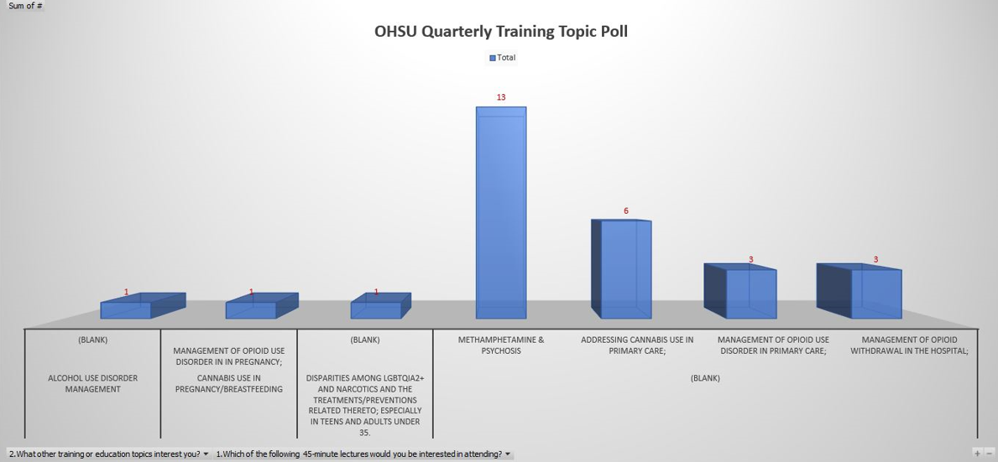
Intervention 5: Provider Feedback on Training Topic Priorities
The Behavioral Health Committee began soliciting regular provider feedback on training priorities, which will continue and inform trainings provided in 2024
Priority Area 3: Increase behavioral health service availability through workforce development

Slide 50
Intervention 6: Forge partnership with at least one higher education academic institution to develop and promote distance learning program to increase local behavioral health workforce by Q4 2024
Monthly Behavioral Health Trainings provided by OHSU on priority topics established by the Behavioral Health Subcommittee
Established Partnership with OHSU in 2023
Quarterly Voting on Priority Training Topics in Behavioral Health Subcommittee
Trainings Provided by OHSU in 2023
Intervention was revised to align with the community identified need for greater local training resources and opportunities to increase the capacity of behavioral health professionals.
Revised Intervention:
Develop and promote workforce development, training, and educational opportunities for current and aspiring behavioral health professionals.
Priority Area 3: Increase behavioral health service availability through workforce development

Slide 51
Goal revisions
Intervention 1
Intervention 2
Original Intervention
Intervention 3
Intervention 6
Original Intervention
Intervention 4
Create local training pathways for traditional health workers in partnership with community organizations to increase THW workforce
Original Intervention
Original Intervention
Original Intervention #6
Revised Intervention # 3:
Develop and offer (3) Eating Disorder trainings for Douglas County community by Q2 2022
Fund credentialing of at least (5) local behavioral health providers through The International Association Of Eating Disorders Professionals (IADEP) by Q4 2023
Require REALD data to be collected on all UHA credentialed/ contracted providers by Q4 2023 to accurately assess provider to member demographics
Forge partnership with at least one higher education academic institution to develop and promote distance learning program to increase local behavioral health workforce by Q4 2024
Increase local training and education opportunities to expand access to evidence-based treatment modalities
Increase the cultural and linguistic diversity of contracted behavioral health providers
Revised Intervention # 4
New Intervention # 5
Develop and promote workforce development, training, and educational opportunities for current and aspiring behavioral health professionals.
Updated Intervention #1
Increase access to peer delivered services for individuals with behavioral health needs
Updated Intervention # 2
Enhance provider capacity to treat eating disorders through partnership with Willamette Nutrition Source​
Intervention 5
Original Intervention
Form Southwest Oregon Collaborative impact team by Q4 2022
This intervention was updated in previous progress report
Develop and promote workforce development, training, and educational opportunities for current and aspiring behavioral health professionals.
Previously Removed
Previously Removed
Revised
Completed
Completed
Revised
Completed interventions were updated to continue driving improvements in target areas
Intervention 3 was revised in progress report 1 due to prohibitive clinical hour requirements to receive IADEP’s credential. The intervention was modified to reflect feedback received from the community in 2023 around the need for greater access to evidence-based treatment modalities
Intervention 4 was revised to broaden focus on health equity and ultimately improve the cultural and linguistic diversity of contracted providers
Intervention 5 & 6 were combined and the intervention was revised to align with the community-identified need for greater local training resources and opportunities to increase the capacity of behavioral health professionals
Priority Area 3: Increase behavioral health service availability through workforce development

Slide 52
Priority Area 3: Commentary
GOALS FOR NEXT YEAR
Intervention 1: Increase access to peer delivered services for individuals with behavioral health needs
Intervention 4: Increase the cultural and linguistic diversity of contracted behavioral health providers
Intervention 5: Develop and promote workforce development, training, and educational opportunities for current and aspiring behavioral health professionals.
Intervention 3: Increase local training and education opportunities to expand access to evidence-based treatment modalities
Increase number of behavioral health providers with REAL+D and SOGI data by 50% in 2024
Increase provider's utilization of eating disorder consultation by 50% in 2024
Increase contracted behavioral health peer delivered service providers by 10% in 2024
Increase utilization of behavioral health peer delivered services by 2% in 2024
Solicit provider feedback on desired training topics and host at least one prioritized training topic each quarter in 2024, through the Behavioral Health Subcommittee.
Incentivize provider engagement in trainings designed to enhance social emotional services for young children, Train at least 5 providers through Social Emotional Workforce Development Incentive Program by the end of Q4 2024
Solicit provider feedback on desired training topics and host at least one prioritized training topic each quarter in 2024, through the Behavioral Health Subcommittee.
Provide at least two trainings on Motivational Interviewing in 2024 through partnership with Douglas Public Health Network
By the end of Q4 2024, increase provider engagement in social emotional workforce development by incentivizing participation. Track the number of providers participating in the workforce development trainings offered.
Increase the number of practices that employ peer delivered services in 2024.
Intervention 2: Enhance provider capacity to treat eating disorders through partnership with Willamette Nutrition Source​
Begin monitoring utilization of eating disorder consultation; increase contracted provider utilization of eating disorder consultation with Willamette Nutrition Source by 3%.
Monitor the number of members treated for eating disorders and target outreach to the top five (5) providers treating eating disorders to provide education on the consultation resources available
Develop consent process for UHA to obtain contracted behavioral health provider’s demographic question responses provided in Healthcare Workforce Reporting Survey issued by licensure boards by Q2 2024
Conduct biannual assessment of contracted behavioral health provider’s REAL+D & SOGI data beginning Q2 2024
Evaluate cultural and linguistic responsiveness of contracted behavioral health provider panel by comparing provider to member demographics, report findings to the Behavioral Health Subcommittee by Q4 2024
Enhance provider directory information to begin publishing information on contracted providers available to provide/offer clinical supervision to associate-level behavioral health clinicians
Priority Area 3: Increase behavioral health service availability through workforce development

Slide 53
Future Goals, Upcoming Dates & Decisions
Increase the cultural and linguistic diversity of contracted behavioral health providers
Improve the capacity of contracted providers to treat behavioral health disorders
Conduct biannual assessment of contracted behavioral health provider’s REAL+D & SOGI data beginning Q2 2024
Develop provider consent process for UHA to obtain Healthcare Workforce Reporting Data from OHA by Q2 2024
Implement & publish updated provider contracting application by the end of Quarter 1, 2024
UHA is developing a process to collect language proficiency exams from bilingual providers. This will allow UHA to confirm which providers are able to provide in-language services to UHA members. UHA plans to include this information in the provider directory as well. community capacity for service delivery
UHA will establish a digital training library for providers, which will monitor and track all trainings completed
Develop Social Emotional Workforce Development Incentive Program. Begin incentivizing provider engagement in training by the end of Q4 2024.
Create local training pathways for traditional health workers
Implement a pilot financial model to sustain enhanced THW services through ILOS THW Program.
Promote workforce development scholarships funded by Ford Family Foundation, increasing uptake by at least two contracted behavioral health providers by Q3 2024
Increase local clinical supervision opportunities for unlicensed and/or associate-level providers by Q3 2024
Priority Area 3: Increase behavioral health service availability through workforce development

Slide 54
Community Engagement
Events
Identified Gap:
UHA shared progress made towards workforce development efforts with over 60 Community Partners and contracted providers at the Young Children's Social-Emotional Health Community meeting that was held on December 12, 2023
UHA participated in an annual community event with the Mexican Consulate, during their visit on October 28
Ongoing socializing of training opportunities across contracted provider network at monthly Behavioral Health Committee Meetings
Behavioral Health workforce shortage has impacted Cow Creek Health & Wellness, which limited their ability to engage with UHA in 2023
There is a need for a Tribal Liaison to improve the ongoing collaboration with UHA and ensure Tribal Leadership inclusion/voice at the table
Cow Creek Hired a new Clinical Director in Q3 of 2023 and began participating in monthly Behavioral Health Committee meetings
Priority Area 3: Increase behavioral health service availability through workforce development

Slide 55
2023 Annual Behavioral Health Report Metrics
Wraparound Data Element | Count of UHA Members
Wraparound Eligible Youth (Identified as meeting criteria for wraparound as defined by multisystem involvement using the SOC Dashboard) | 208
Wraparound Enrollment (UHA Members enrolled in wraparound from among those determined to meet criteria) | 24
Race of Youth Enrolled: Number of UHA Members enrolled in wraparound by race | 3 unknown 2 African American/Caucasian 1 Native Hawaiian/ Other Pacific Islander 1 Caucasian/Hispanic 17 Caucasian
Ethnicity of Youth Enrolled: Number of UHA Members enrolled in wraparound by ethnicity | 3 unknown 2 African American/Caucasian 1 Native Hawaiian/ Other Pacific Islander 1 Caucasian/Hispanic 17 Caucasian
Language of Youth Enrolled: Number of UHA Members enrolled in wraparound by language | 24 English
Priority Area 3: Increase behavioral health service availability through workforce development

