Slide 1
Comprehensive Behavioral Health Plan
(CBHP)
Progress Report 3
July 2023 - October 2024

Slide 2
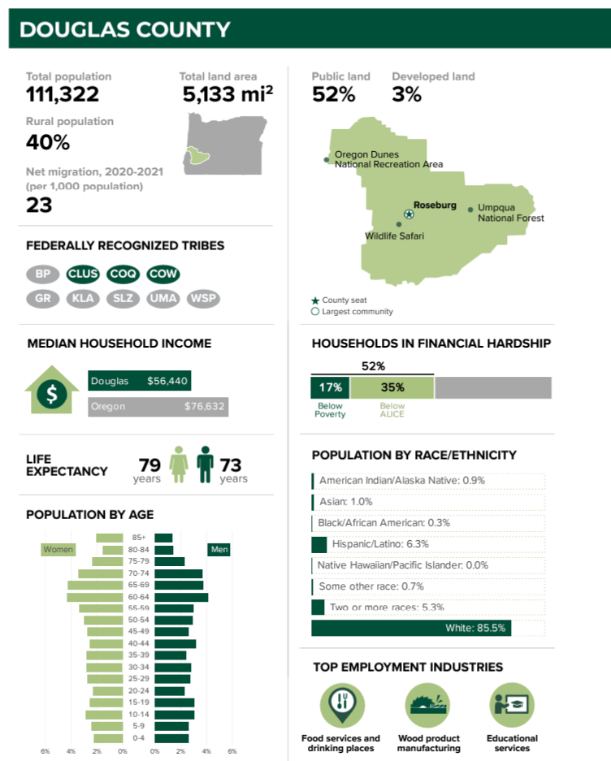
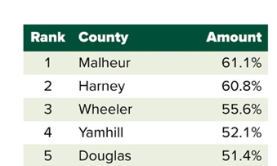
Umpqua Health:
Deeply Rooted in Douglas County
We have served Oregon Health Plan members for over 27 years
Data from Oregon by the Numbers from The Ford Family Foundation and Oregon State University, 2024 Report

Slide 3
Umpqua Health:
Deeply Rooted in Douglas County
We have served Oregon Health Plan members for over 27 years
Data from Oregon by the Numbers from The Ford Family Foundation and Oregon State University, 2024 Report

Slide 4
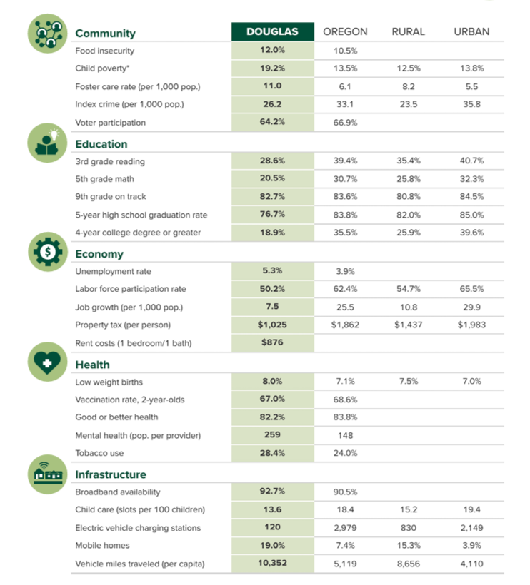
Who We Serve, Our Members
Data from Oregon by the Numbers from The Ford Family Foundation and Oregon State University, 2024 Report

Slide 5

Land Acknowledgement
We want to respectfully acknowledge the Cow Creek Band of Umpqua Tribe of Indians ("Tribe" or "Cow Creek"), who have stewarded these lands since time immemorial. ​
We want to further acknowledge the Tribe's deep cultural and spiritual connection to these lands in addition to its entire interest and ancestral areas, which includes more than six million acres located within the Rogue and Umpqua River Watersheds. These lands and the vibrant resources within them have been important since time immemorial and will continue to be a vibrant part of Tribe's cultural identity for generations to come. ​
We recognize the preexisting and continued sovereignty of the Tribe and thank them for continuing to share their Indigenous knowledge and perspective on how we might work together to manage and care for these shared resources sustainably, with mutually beneficial outcomes. ​
We commit to engaging in a respectful, meaningful, and successful partnership as we explore shared stewardship of these lands.

Slide 6
Umpqua Health Overview
Mission
Values
Agreements
Health Equity
Promote and provide high quality, readily accessible healthcare in a patient-centered system of care for those we serve. ​
Accountability​
Efficiency​
Be a Team Player​
Integrity ​
Stewardship
Clear about our purpose before we act​
Present and engaged with one another as we work​
Real and authentic in our communication​
Connected through being kind and caring​
Creative and innovative individually and collectively
UH works to achieve health equity for all population groups by allocating resources towards designing policies and programs to create greater social justice in health

Slide 7
Our Values
Accountability
Integrity
Efficiency
Stewardship
Be a Team Player
Support and assist your team members. Be available to help and learn from your team. Keep an open mind to feedback and earn trust of staff​.
Always demonstrate the highest performance and behavior standards. Share responsibility and expect others to be accountable.​
Keep your promises, commitments, and confidences. Be honest, and straightforward dealing with all issues fairly and consistently.
Demonstrate a proactive approach to problem identification and solutions. Be innovative and solutions oriented, improving processes while reducing costs. Demonstrate appropriate time management skills. Optimize the use of available resources.
Adhere to all state and federal regulations relating to your position including the Health Insurance Portability and Accountability Act (HIPAA), Fraud & Abuse and Occupational Safety and Health Administration (OSHA) laws. Always abide by company policies and procedures.​

Slide 8
Equity Statement
Umpqua Health (UH) recognizes the importance of treating emotional, psychological, and social well-being with the same care as physical health concerns. Collaboration and integration between physical health and mental/behavioral health agencies improves health outcomes and overall continuity of care. The behavioral health integration team supports the delivery of community-based healthcare; cultivates diversity, equity, and inclusion internally and externally by respecting and valuing all individual’s cultural beliefs and practices, health literacy, preferred languages, and communication needs. ​
UH shares the mission of Oregon Health Authority’s Child and Family Behavioral Health (CFBH) unit to incorporate System of Care values and trauma-informed approaches to provide efficient and effective behavioral health services and supports for Oregon's children, youth, young adults, and their families. System of care values include prioritizing the creation of a sustainable community-based continuum of quality care that is individualized, responsive, meaningful, youth guided, family driven, culturally responsive, and evidence based. ​
We strive to achieve and implement continuous improvements in UH’s Behavioral Health program by enhancing behavioral health network adequacy and access, supporting delivery system transformation, and the development and implementation of a formal program integrity plan. The Behavioral Health Integration Team will continue to identify and reduce gaps in services, decrease inefficiencies, and improve overall member experience.

Slide 9

Equity Statement
UH is committed to fostering health equity in the communities we serve. We recognize the importance of addressing social determinants of health and acknowledging the unique strengths and assets within our organization to reduce health inequities. ​
Our health equity statement is as follows: “UH’s mission works to achieve health equity for all population groups by allocating resources towards designing policies and programs to create greater social justice in health.”

Slide 10
Equity Strengths & Measurements
UH understands the pursuit of equity is an ongoing process and therefore has allocated resources to continue this work. The Director of Health Equity, Diversity, and Inclusion who serves as the Health Equity Administrator is responsible for tracking progress in this area through the annual Health Equity Plan submission to the OHA, as well as in UH’s internal Culturally and Linguistically Appropriate Services (CLAS) workgroup and through the NCQA Health Equity Accreditation process. ​
In each of these areas, UH evaluates data to identify disparities related to race and ethnicity, language, disability, sexual orientation, and gender identity. This data is monitored by the Quality Improvement Committee (QIC), and relevant subcommittees, and interventions are identified and implemented based on these findings. As part of the annual evaluation of the CLAS and Quality work plan, UH evaluates the effectiveness of these interventions and acts based on these analyses. This information is shared with the QIC, board, and Community Advisory Committee (CAC) to ensure effective communication to and feedback from all relevant stakeholders.

Slide 11
Our Commitment to Aligning with the CHP is Exhibited Throughout Our CBHP's Three Priority Areas
Housing​
Improve involvement in community housing initiatives to improve housing accessibility, affordability, and availability for members with Behavioral Health concerns​.
Behavioral Health Treatment​
Enhance the Behavioral Health service array across the continuum of care and increase community capacity to provide treatment at higher levels of care.​
Workforce Development​
Increase service availability through behavioral health workforce development by engaging community stakeholders to create, promote, and support educational & training initiatives.

Slide 12
Aligning with the CHA and CHIP
Helps the CCO and other community health leaders identify priority areas
Community Health Assessment
Opportunity for the community to give the CCO feedback on the needs of the community
Examines existing health data and gathers additional data from systems and providers
Collects community member feedback via focus groups and community surveys
Community Health Improvement Plan
Opportunity for the CCO to address the needs of the community
Sets goals for filling gaps in services
CBHP

Slide 13
Identified CHA Health Areas
Goal 2: Reduce stigma and increase community awareness that behavioral health and addiction issues are common and widely experienced.
Priority 1:
Social Determinants of Health
Goal 1: Ensure that all people in Douglas County live, work and play in a safe and healthy environment and have equitable access to stable, safe, affordable housing, transportation, childcare, social services, and other essential infrastructure so that they may live a healthy resilient life.
Goal 2: Ensure Douglas County organizations create, and support opportunities aimed at fostering excellence and proficiency across all person-serving institutions.
Priority 2:
Families & Children
Goal 1: Collaborate with education partners to build a community-wide understanding of the barriers to K-12 school attendance and the factors contributing to absenteeism rates.
Goal 2: Enhance resilience by fostering safe, connected, and strengths-based environments for individuals, families, caregivers, and communities.
Priority 3:
Healthy Lifestyles
Goal 1: Create a culture of health in Douglas County.
Goal 2: Ensure all Douglas County residents have access to healthy, nutritious, and affordable food that meets their dietary and cultural needs.
Priority 4:
Behavioral Health and Addiction
Goal 1: Provide more accessible and culturally aware behavioral health and addiction services in diverse locations.

Slide 14
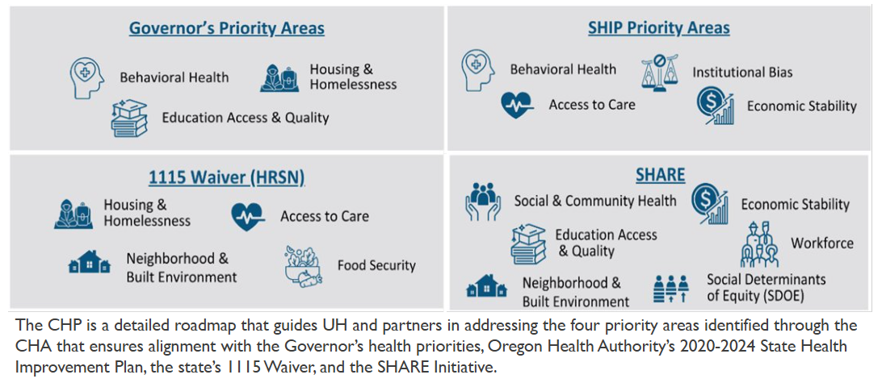
Identified Priority Areas

Slide 15
Priority Area 1
IMPROVE INVOLVEMENT IN COMMUNITY HOUSING INITIATIVES TO IMPROVE ACCESSIBILITY, AFFORDABILITY, AND AVAILABILITY FOR MEMBERS WITH BEHAVIORAL HEALTH CONCERNS
Priority area 1: IMPROVE INVOLVEMENT IN COMMUNITY HOUSING INITIATIVES TO IMPROVE ACCESSIBILITY, AFFORDABILITY, AND AVAILABILITY FOR MEMBERS WITH BEHAVIORAL HEALTH CONCERNS
Priority area 1: IMPROVE INVOLVEMENT IN COMMUNITY HOUSING INITIATIVES TO IMPROVE ACCESSIBILITY, AFFORDABILITY, AND AVAILABILITY FOR MEMBERS WITH BEHAVIORAL HEALTH CONCERNS

Slide 16

COMPLETE
COMPLETE
COMPLETE
Intervention 1: Strategic involvement with community partners, focusing on housing capacity developments ​
Intervention 2: Increase investment in infrastructure development focused on housing for individuals with behavioral health needs​
Intervention 3: Increase youth and family-centered housing resources
Priority area 1: IMPROVE INVOLVEMENT IN COMMUNITY HOUSING INITIATIVES TO IMPROVE ACCESSIBILITY, AFFORDABILITY, AND AVAILABILITY FOR MEMBERS WITH BEHAVIORAL HEALTH CONCERNS

Slide 17
Intervention 1: | Strategic Involvement with Community Partners, Focusing on Housing Capacity Developments
Objective 1: Attend all the Homeless Transition Action Group (HTAG) and LPSCC Behavioral Health and Housing Subcommittee Meetings in 2024 to increase strategic involvement with community partners.
Objective 2: Gather information from meetings focused on housing capacity developments and promote the Share Application
Objective 3: Increase referrals to Neighborworks Umpqua’s Housing Stability Program by 3% by the end of Q4 2024.
Objective 4: Participate in the annual Point in Time Houseless count in January 2025.
Objective 5: Socialize housing capacity development updates with the Behavioral Health Committee, at least once quarterly throughout 2024.
AL
L
COMP
L
E
T
E

Slide 18
Objective 1: | Attend all Homeless Transition Action Group (HTAG) meetings and LPSCC Behavioral Health & Housing Subcommittee Meetings in 2024 to increase strategic involvement with community partners.
COMPLETE
Homeless Transition Action Group (HTAG)
Local Public Safety Coordinating Council (LPSCC) Behavioral Health & Housing Subcommittee
Key Partners: HIV Alliance, Adapt, Mercy Medical Center Behavioral Health Unit, Gary Leif Navigation Center, Housing Authority of Douglas County, Family Development Center, Specialty Courts of Douglas County, Tasha's House, and others.
Key Partners: South Umpqua School District, DHS, City of Roseburg, Housing First Umpqua, Greater Douglas United Way, Common Thread LLC, Umpqua Community Health Center, UCAN, HIV Alliance, City of Sutherlin, Adapt, Housing Authority of Douglas County, Onward Roseburg, Veterans Administration, Peace at Home, AVIVA Health, Chadwick Club House, Douglas County Human Trafficking, HADCO, Habitat for Humanity, Neighborworks Umpqua, and others.
During reporting period, LPSCC held 13 meetings.
Of the 13 held, UH attended 85%, or 11 meetings.
During reporting period, HTAG held 12 meetings.
Of the 12 held, UH attended 100%, or 12 meetings.
Priority area 1: IMPROVE INVOLVEMENT IN COMMUNITY HOUSING INITIATIVES TO IMPROVE ACCESSIBILITY, AFFORDABILITY, AND AVAILABILITY FOR MEMBERS WITH BEHAVIORAL HEALTH CONCERNS

Slide 19
Objective 2: | Gather information from meetings focused on housing capacity developments and promote the Share Application
COMPLETE
Homeless Transition Action Group (HTAG)
Local Public Safety Coordinating Council (LPSCC) Behavioral Health & Housing Subcommittee
Urban Campground
Under the Bridge Ministry
Gary Leif Navigation Center
Community Shelters
HIV Alliance Naloxone Supply
Permanent Housing& Immediate Needs Subcommittees
UHA Homeless Outreach and Supplies
UCAN Warming Centers
Roseburg’s 3 Camp Camps-To-Village
Connecting Point Utilization
Review Disposition Calls for Services Involving persons with mental health concerns through Douglas County Sheriff’s Office.
Transitional housing
Homeless Transition Action Group
Oxford House Transitional Housing
Roseburg Youth Housing Campus
IMPACTS Grant
Adapt Opioid Treatment Center Program
Mobile Crisis/988 Program
Crisis Resolution Rooms
Sobering Center
Priority area 1: IMPROVE INVOLVEMENT IN COMMUNITY HOUSING INITIATIVES TO IMPROVE ACCESSIBILITY, AFFORDABILITY, AND AVAILABILITY FOR MEMBERS WITH BEHAVIORAL HEALTH CONCERNS

Slide 20
Objective 2: | Gather information from meetings focused on housing capacity developments and promote the Share Application
COMPLETE
Community Capacity Building Funds Informational Webinar
On February 28, 2024, Umpqua Health held a community webinar to discussed SHARE applications and how these funds can be used.
Pre-recorded and accessible on our webpage Community Capacity Building Funds Informational Webinar
Presentations shared at both the LPSCC in April 2024 and HTAG Meeting in March and April 2024 meetings by Umpqua Health staff
System of Care Breakfast Presentation on Community Impact Opportunities
On June 20, 2024, Umpqua Health staff presented on SHARE, CHIP, HRSF, HRSN, Community Benefit Initiatives, In Lieu of Services (ILOS) and Community Advisory Council (CAC)
Priority area 1: IMPROVE INVOLVEMENT IN COMMUNITY HOUSING INITIATIVES TO IMPROVE ACCESSIBILITY, AFFORDABILITY, AND AVAILABILITY FOR MEMBERS WITH BEHAVIORAL HEALTH CONCERNS

Slide 21
Objective 3: | Increase referrals to Neighborworks Umpqua’s Housing Stability Program by 3% by the end of Q4 2024.
COMPLETE
$34,500 granted to provide financial assistance to low-income residents for rental deposits, moving expenses, furniture, and food during their transition into permanent affordable housing.
In 2024, there were 45 housing referrals from 5 agencies received.
31 new tenants received assistance for housing attainment through first month’s rent, processing fees, etc., 17 were helped with start-up food, and 5 were helped with basic furniture
Priority area 1: IMPROVE INVOLVEMENT IN COMMUNITY HOUSING INITIATIVES TO IMPROVE ACCESSIBILITY, AFFORDABILITY, AND AVAILABILITY FOR MEMBERS WITH BEHAVIORAL HEALTH CONCERNS

Slide 22
Objective 4: | Participate in the 2024 Point in Time Houseless Count
COMPLETE
UH participated in the annual Point in Time Houseless count in January 2024.​
Care Coordination Navigator Lead, Heather Carter, attended the event.
Data shown is confirmed by the Continuum of Care, but pending HUD confirmation in 2025
UH provided information on our programs and Social Determinant of Health resources. Supplies were distributed such as hand warmers, hand sanitizer, body wipes, etc.
6,459
People experiencing homelessness
5,063
Unsheltered
1,396
Sheltered
Priority area 1: IMPROVE INVOLVEMENT IN COMMUNITY HOUSING INITIATIVES TO IMPROVE ACCESSIBILITY, AFFORDABILITY, AND AVAILABILITY FOR MEMBERS WITH BEHAVIORAL HEALTH CONCERNS

Slide 23
Objective 4: | Participate in the 2024 Point in Time Houseless Count
COMPLETE
Priority area 1: IMPROVE INVOLVEMENT IN COMMUNITY HOUSING INITIATIVES TO IMPROVE ACCESSIBILITY, AFFORDABILITY, AND AVAILABILITY FOR MEMBERS WITH BEHAVIORAL HEALTH CONCERNS

Slide 24
Objective 5: | Socialize housing capacity development updates with the Behavioral Health Committee, at least once quarterly throughout 2024.
Adapt’s Progress Point (previously Recovery Lodge) was at 50% capacity in 2023, which increased to 75% in 2024. The current capacity has increased to 15 beds.
Housing is offered for 24 hours at a time at no cost. Service requirements include regular engagement with a Peer Support Specialist and progressing towards goals throughout the first 60 days.
COMPLETE
Priority area 1: IMPROVE INVOLVEMENT IN COMMUNITY HOUSING INITIATIVES TO IMPROVE ACCESSIBILITY, AFFORDABILITY, AND AVAILABILITY FOR MEMBERS WITH BEHAVIORAL HEALTH CONCERNS

Slide 25
Objective 5: | Socialize housing capacity development updates with the Behavioral Health Committee, at least once quarterly throughout 2024.
COMPLETE
Peace at Home
FARA
Offer crisis intervention, peer support and safety planning, with weekly socialization activities.
Tasha's House
UH Granted $393,068 to open two additional shelter units and refresh 4 pre-existing units in 2024.
Offering LGBTQ+ support services to youth on the Youth Housing Campus and conduct community engagement activities.
Maintain 8-10 beds for houseless and/or runaway youth needing crisis shelter services.
20 units available to individuals in need of core services (domestic violence and sexual assault response/advocacy).
Finalizing Youth Housing Campus development which will have five rooms for transitional housing for people 18-24 with or without children.
Recruiting a Housing and Healthcare Worker to provide case management services directly on campus.
In early 2025: Implementing a youth shelter program for 11 to 17-year-olds on the Youth Housing Campus.
Priority area 1: IMPROVE INVOLVEMENT IN COMMUNITY HOUSING INITIATIVES TO IMPROVE ACCESSIBILITY, AFFORDABILITY, AND AVAILABILITY FOR MEMBERS WITH BEHAVIORAL HEALTH CONCERNS

Slide 26
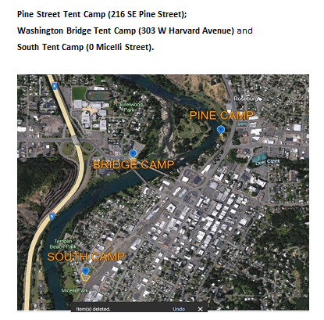
Objective 5: | Socialize housing capacity development updates with the Behavioral Health Committee, at least once quarterly throughout 2024.
COMPLETE
The City of Roseburg approved three (3) legal tent camp developments
These sites will require residents to be drug and alcohol free and participate in programming for a minimum of three hours each day
Priority area 1: IMPROVE INVOLVEMENT IN COMMUNITY HOUSING INITIATIVES TO IMPROVE ACCESSIBILITY, AFFORDABILITY, AND AVAILABILITY FOR MEMBERS WITH BEHAVIORAL HEALTH CONCERNS

Slide 27
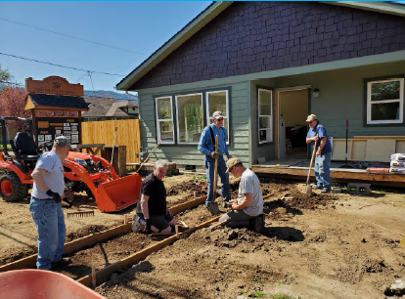
Objective 5: | Socialize housing capacity development updates with the Behavioral Health Committee, at least once quarterly throughout 2024.
COMPLETE
Habitat for Humanity is building Twin Oaks Neighborhood in Riddle, Oregon.
  20 affordable single-family home lots
  Began construction in Fall 2024
November 2024, the first Habitat ReStore opened in Roseburg, OR on 1026 NE Diamond Lake Blvd.
  Takes in donations of furniture, building supplies, and hardware.
SHARE Investment Reporting. (2024). [Photograph].
Priority area 1: IMPROVE INVOLVEMENT IN COMMUNITY HOUSING INITIATIVES TO IMPROVE ACCESSIBILITY, AFFORDABILITY, AND AVAILABILITY FOR MEMBERS WITH BEHAVIORAL HEALTH CONCERNS

Slide 28
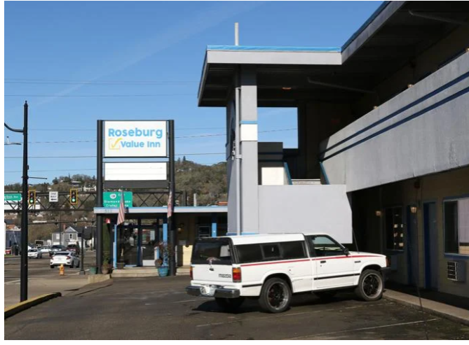
Objective 5: | Socialize housing capacity development updates with the Behavioral Health Committee, at least once quarterly throughout 2024.
COMPLETE
Adapt Rodeway Project (Value Inn)
$829,868 granted to Adapt for acquisition, repair, and renovation of a 50-unit facility for transitional housing for individuals with behavioral health needs.
Additional services include peer support and mental health counseling to enhance outcomes and engagement in health services (KPIC).
SHARE Investment Reporting. (2024). [Photograph].
Priority area 1: IMPROVE INVOLVEMENT IN COMMUNITY HOUSING INITIATIVES TO IMPROVE ACCESSIBILITY, AFFORDABILITY, AND AVAILABILITY FOR MEMBERS WITH BEHAVIORAL HEALTH CONCERNS

Slide 29
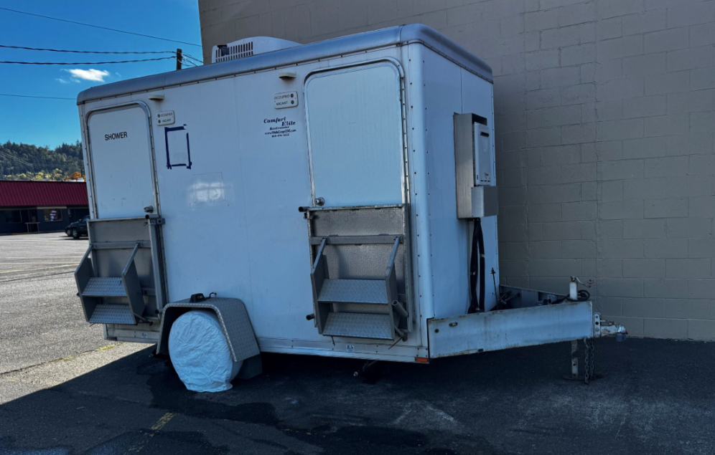
Objective 5: | Socialize housing capacity development updates with the Behavioral Health Committee, at least once quarterly throughout 2024.
$500,000 granted to the Dream Center
Resource Expansion
Assisting at-risk and vulnerable populations.
August 2024: Fully operational shower trailer
Essential supports such as food, clothing, hygiene products, haircuts and housing assistance
October 2024: Fully functional food trailer
September 2024: Industrial fridge and freezer moved and updated
COMPLETE
SHARE Investment Reporting. (2024). [Photograph].
Priority area 1: IMPROVE INVOLVEMENT IN COMMUNITY HOUSING INITIATIVES TO IMPROVE ACCESSIBILITY, AFFORDABILITY, AND AVAILABILITY FOR MEMBERS WITH BEHAVIORAL HEALTH CONCERNS

Slide 30
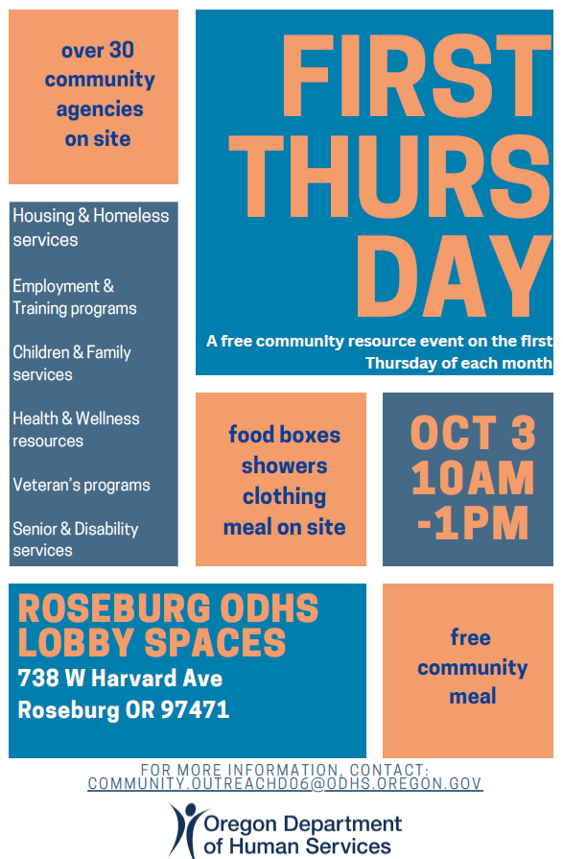
Objective 5: | Socialize housing capacity development updates with the Behavioral Health Committee, at least once quarterly throughout 2024.
COMPLETE
Regular community resource events are held on the first Thursday of each month to provide information regarding:
Housing and homeless services
Employment and training programs
Children and family services
Health and wellness resources
Veteran's programs as well as senior and disability services
Priority area 1: IMPROVE INVOLVEMENT IN COMMUNITY HOUSING INITIATIVES TO IMPROVE ACCESSIBILITY, AFFORDABILITY, AND AVAILABILITY FOR MEMBERS WITH BEHAVIORAL HEALTH CONCERNS

Slide 31
Intervention 2: | Increase Investment in Infrastructure Development Focused on Housing for Individuals with Behavioral Health Needs
Increase the number of members with substance use disorders provided transitional housing through Adapt’s Progress Point (previously called Recovery Lodge) by at least 2% in 2024.​
Increase the capacity of Adapt's Rodeway Project (Value Inn) for individuals experiencing behavioral health concerns and in need of transitional housing, by adding 10 beds by the end of 2024.​
Implement quarterly tracking and monitoring of the number of members with behavioral health needs receiving financial assistance for housing-related needs. Identify trends and opportunities for improvement in housing support services.​
IN PROGRESS
IN PROGRESS
COMPLETE
Priority area 1: IMPROVE INVOLVEMENT IN COMMUNITY HOUSING INITIATIVES TO IMPROVE ACCESSIBILITY, AFFORDABILITY, AND AVAILABILITY FOR MEMBERS WITH BEHAVIORAL HEALTH CONCERNS

Slide 32

Objective 1: | Increase the number of members with substance use disorders provided transitional housing through Adapt’s Progress Point by at least 2% in 2024.​
IN PROGRESS
Adapt is finalizing remodel of the final 3 rooms in this 12-room facility, which will reduce the number of members on the waitlist for transitional housing.
Quarter and Year | Tenants
Quarter 4 | 2023 | 19
Quarter 1 | 2024 | 14
Quarter 2 | 2024 | 29
Quarter 3 | 2024 | 23
Quarter 4 |2024 | 18
Unduplicated Tenants | 54
SHARE Investment Reporting. (2024). [Photograph].
Priority area 1: IMPROVE INVOLVEMENT IN COMMUNITY HOUSING INITIATIVES TO IMPROVE ACCESSIBILITY, AFFORDABILITY, AND AVAILABILITY FOR MEMBERS WITH BEHAVIORAL HEALTH CONCERNS

Slide 33
Objective 2: | Increase the capacity of Adapt's Rodeway Project (Value Inn), by adding 10 beds by the end of 2024.
IN PROGRESS
Remodel is about 60% complete.
UH has reserved 10 beds to support individuals transitioning from higher levels of care
Reserved rooms estimated to be available starting in January of 2025
SHARE Investment Reporting. (2024). [Photograph].
Priority area 1: IMPROVE INVOLVEMENT IN COMMUNITY HOUSING INITIATIVES TO IMPROVE ACCESSIBILITY, AFFORDABILITY, AND AVAILABILITY FOR MEMBERS WITH BEHAVIORAL HEALTH CONCERNS

Slide 34
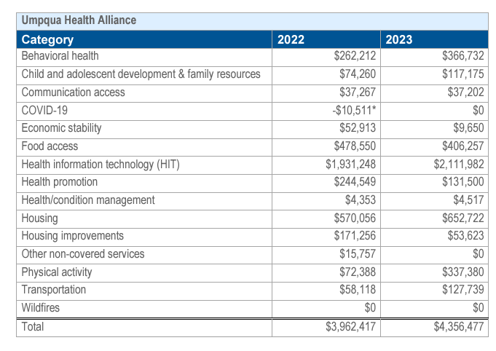
Objective 3: | Implement quarterly tracking and monitoring of the number of members with behavioral health needs receiving financial assistance for housing-related needs.
COMPLETE
2023 CCO Health-Related Services Spending Summary
Illustrates overall spending between 2022 and 2023 on Health-Related Services focused on:
    Behavioral Health
    Housing
    Housing Improvements
    Social Determinants of Health Resources
https://www.oregon.gov/oha/HPA/dsi-tc/Documents/2023-CCO-HRS-Spending-Summary.pdf
Priority area 1: IMPROVE INVOLVEMENT IN COMMUNITY HOUSING INITIATIVES TO IMPROVE ACCESSIBILITY, AFFORDABILITY, AND AVAILABILITY FOR MEMBERS WITH BEHAVIORAL HEALTH CONCERNS

Slide 35
Objective 3: | Implement quarterly tracking and monitoring of the number of members with behavioral health needs receiving financial assistance for housing-related needs.
COMPLETE
2.3% of members identified both a behavioral health condition and housing-related diagnosing need received financial housing assistance through Health-Related Spending or Health Related Social Needs Spending
Last year, we were only capable of reporting the overall spend toward housing-related needs, we could not isolate whether these investments were made for members with behavioral health condition(s).
Umpqua Health designed and implemented a Tableau Dashboard to support tracking and monitoring of dollars spent on house-related needs, focusing on our target population.
*We anticipate significant improvements in this rate in subsequent progress reports, given the recency of the Social Determinant Metric and advent of HRSN benefits.
Priority area 1: IMPROVE INVOLVEMENT IN COMMUNITY HOUSING INITIATIVES TO IMPROVE ACCESSIBILITY, AFFORDABILITY, AND AVAILABILITY FOR MEMBERS WITH BEHAVIORAL HEALTH CONCERNS

Slide 36
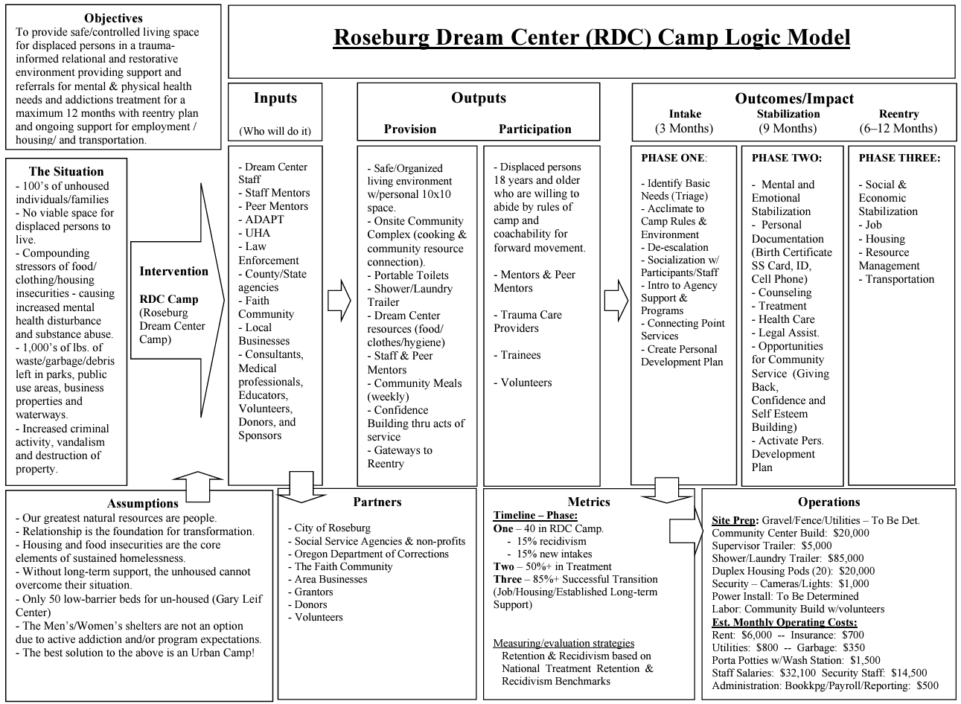
Intervention 2: | Increase Investment in Infrastructure Development Focused on Housing for Individuals with Behavioral Health Needs
Additional Camps and Shelters
Hasting Village-Sutherlin Oregon
The Point-Roseburg Oregon
Micelli Park (in development) Camp-Roseburg Oregon
UCAN and St. Joe’s Warming Center-Roseburg Oregon
Priority area 1: IMPROVE INVOLVEMENT IN COMMUNITY HOUSING INITIATIVES TO IMPROVE ACCESSIBILITY, AFFORDABILITY, AND AVAILABILITY FOR MEMBERS WITH BEHAVIORAL HEALTH CONCERNS

Slide 37
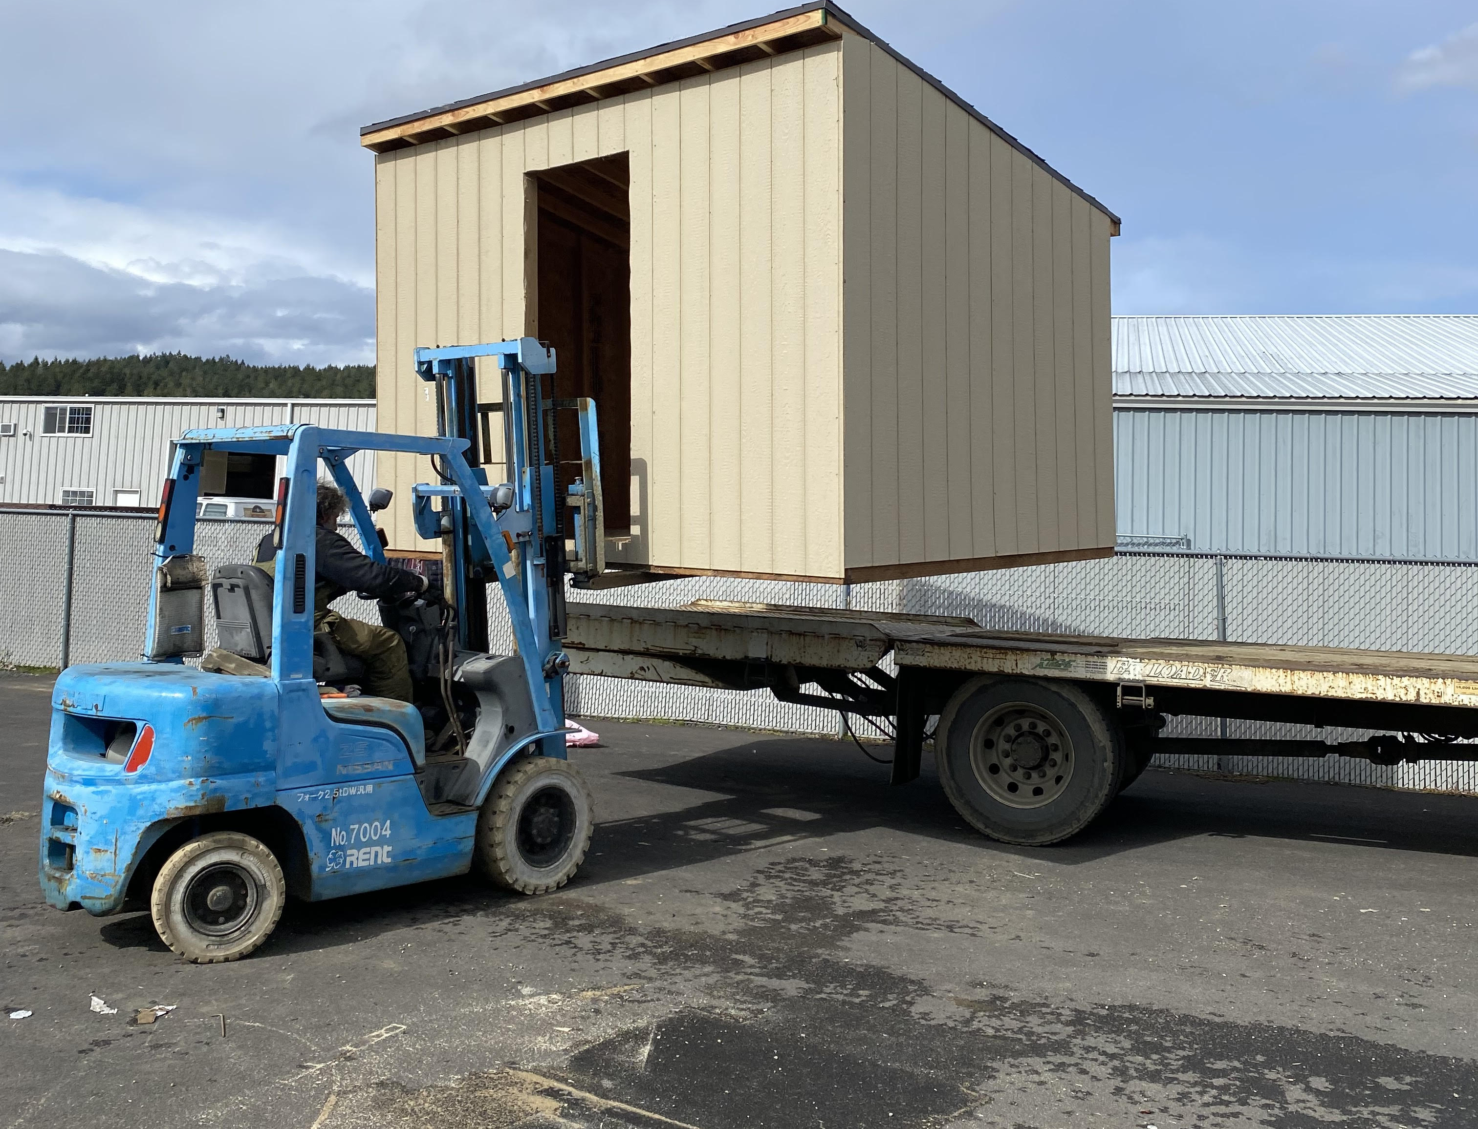
Intervention 2: | Increase Investment in Infrastructure Development Focused on Housing for Individuals with Behavioral Health Needs
$27,890 awarded to Umpqua Heart
To be used on basic need items such as:
Propane and gas cards
Buddy heaters
Bus passes
Tents/tarps/sleeping bags and backpacks.
SHARE Investment Reporting. (2023). [Photograph].
Priority area 1: IMPROVE INVOLVEMENT IN COMMUNITY HOUSING INITIATIVES TO IMPROVE ACCESSIBILITY, AFFORDABILITY, AND AVAILABILITY FOR MEMBERS WITH BEHAVIORAL HEALTH CONCERNS

Slide 38

Intervention 2: | Increase Investment in Infrastructure Development Focused on Housing for Individuals with Behavioral Health Needs
Repair Loan Pool Funding
$25,000 granted
These funds help Habitat for Humanity support qualifying homeowners afford home repairs of their homes by offering a 0% interest loan on which they can make payments over one or two years.
Photo courtesy of Habitat for Humanity
Priority area 1: IMPROVE INVOLVEMENT IN COMMUNITY HOUSING INITIATIVES TO IMPROVE ACCESSIBILITY, AFFORDABILITY, AND AVAILABILITY FOR MEMBERS WITH BEHAVIORAL HEALTH CONCERNS

Slide 39
Intervention 3: | Increase Youth and Family-Centered Housing Resources
Increase family occupancy of Hillside Terrace in 2024 from 50% to 75% by the end of Q4​​.
Open a supportive housing program for transitional aged youth, 18-24, by the end of 2025.
Increase the number of families sheltered through the Gary Leif Navigation Center by 10% by the end of Q4 in 2024​​.
IN PROGRESS
IN PROGRESS
COMPLETE
Priority area 1: IMPROVE INVOLVEMENT IN COMMUNITY HOUSING INITIATIVES TO IMPROVE ACCESSIBILITY, AFFORDABILITY, AND AVAILABILITY FOR MEMBERS WITH BEHAVIORAL HEALTH CONCERNS

Slide 40
Objective 1: | Increase family occupancy of Hillside Terrace in 2024 from 50% to 75% by the end of Q4​​
IN PROGRESS
Over the last two years, we’ve housed 23 families at Hillside Terrace.
Improvements to the buildings include HVAC, furniture, and other items during times of vacancies.
This facility is tenant-paid but also supported by DHS.
SHARE Investment Reporting. (2023). [Photograph].
Priority area 1: IMPROVE INVOLVEMENT IN COMMUNITY HOUSING INITIATIVES TO IMPROVE ACCESSIBILITY, AFFORDABILITY, AND AVAILABILITY FOR MEMBERS WITH BEHAVIORAL HEALTH CONCERNS

Slide 41
Objective 2: | Open a supportive housing program for transitional aged youth, 18-24, by the end of 2025
IN PROGRESS
Oregon Housing and Community Services (OHCS) granted FARA $967K to combat rural homelessness
FARA to start transitional housing for 11–17-year-olds in early 2025, at The Dome Spe, or “Home of Hope."
Crisis intervention, peer support and safety planning with weekly activities for socialization.​
Daytime Drop-In Center:
FARA focuses on youth and their families who are experiencing homelessness, or, at risk of becoming homeless.
8-10 beds for houseless or runaway youth needing crisis shelter services.​
Open 9am-5pm, Monday - Friday
Overnight Shelter Options for youth 11-17 years old.
Priority area 1: IMPROVE INVOLVEMENT IN COMMUNITY HOUSING INITIATIVES TO IMPROVE ACCESSIBILITY, AFFORDABILITY, AND AVAILABILITY FOR MEMBERS WITH BEHAVIORAL HEALTH CONCERNS

Slide 42
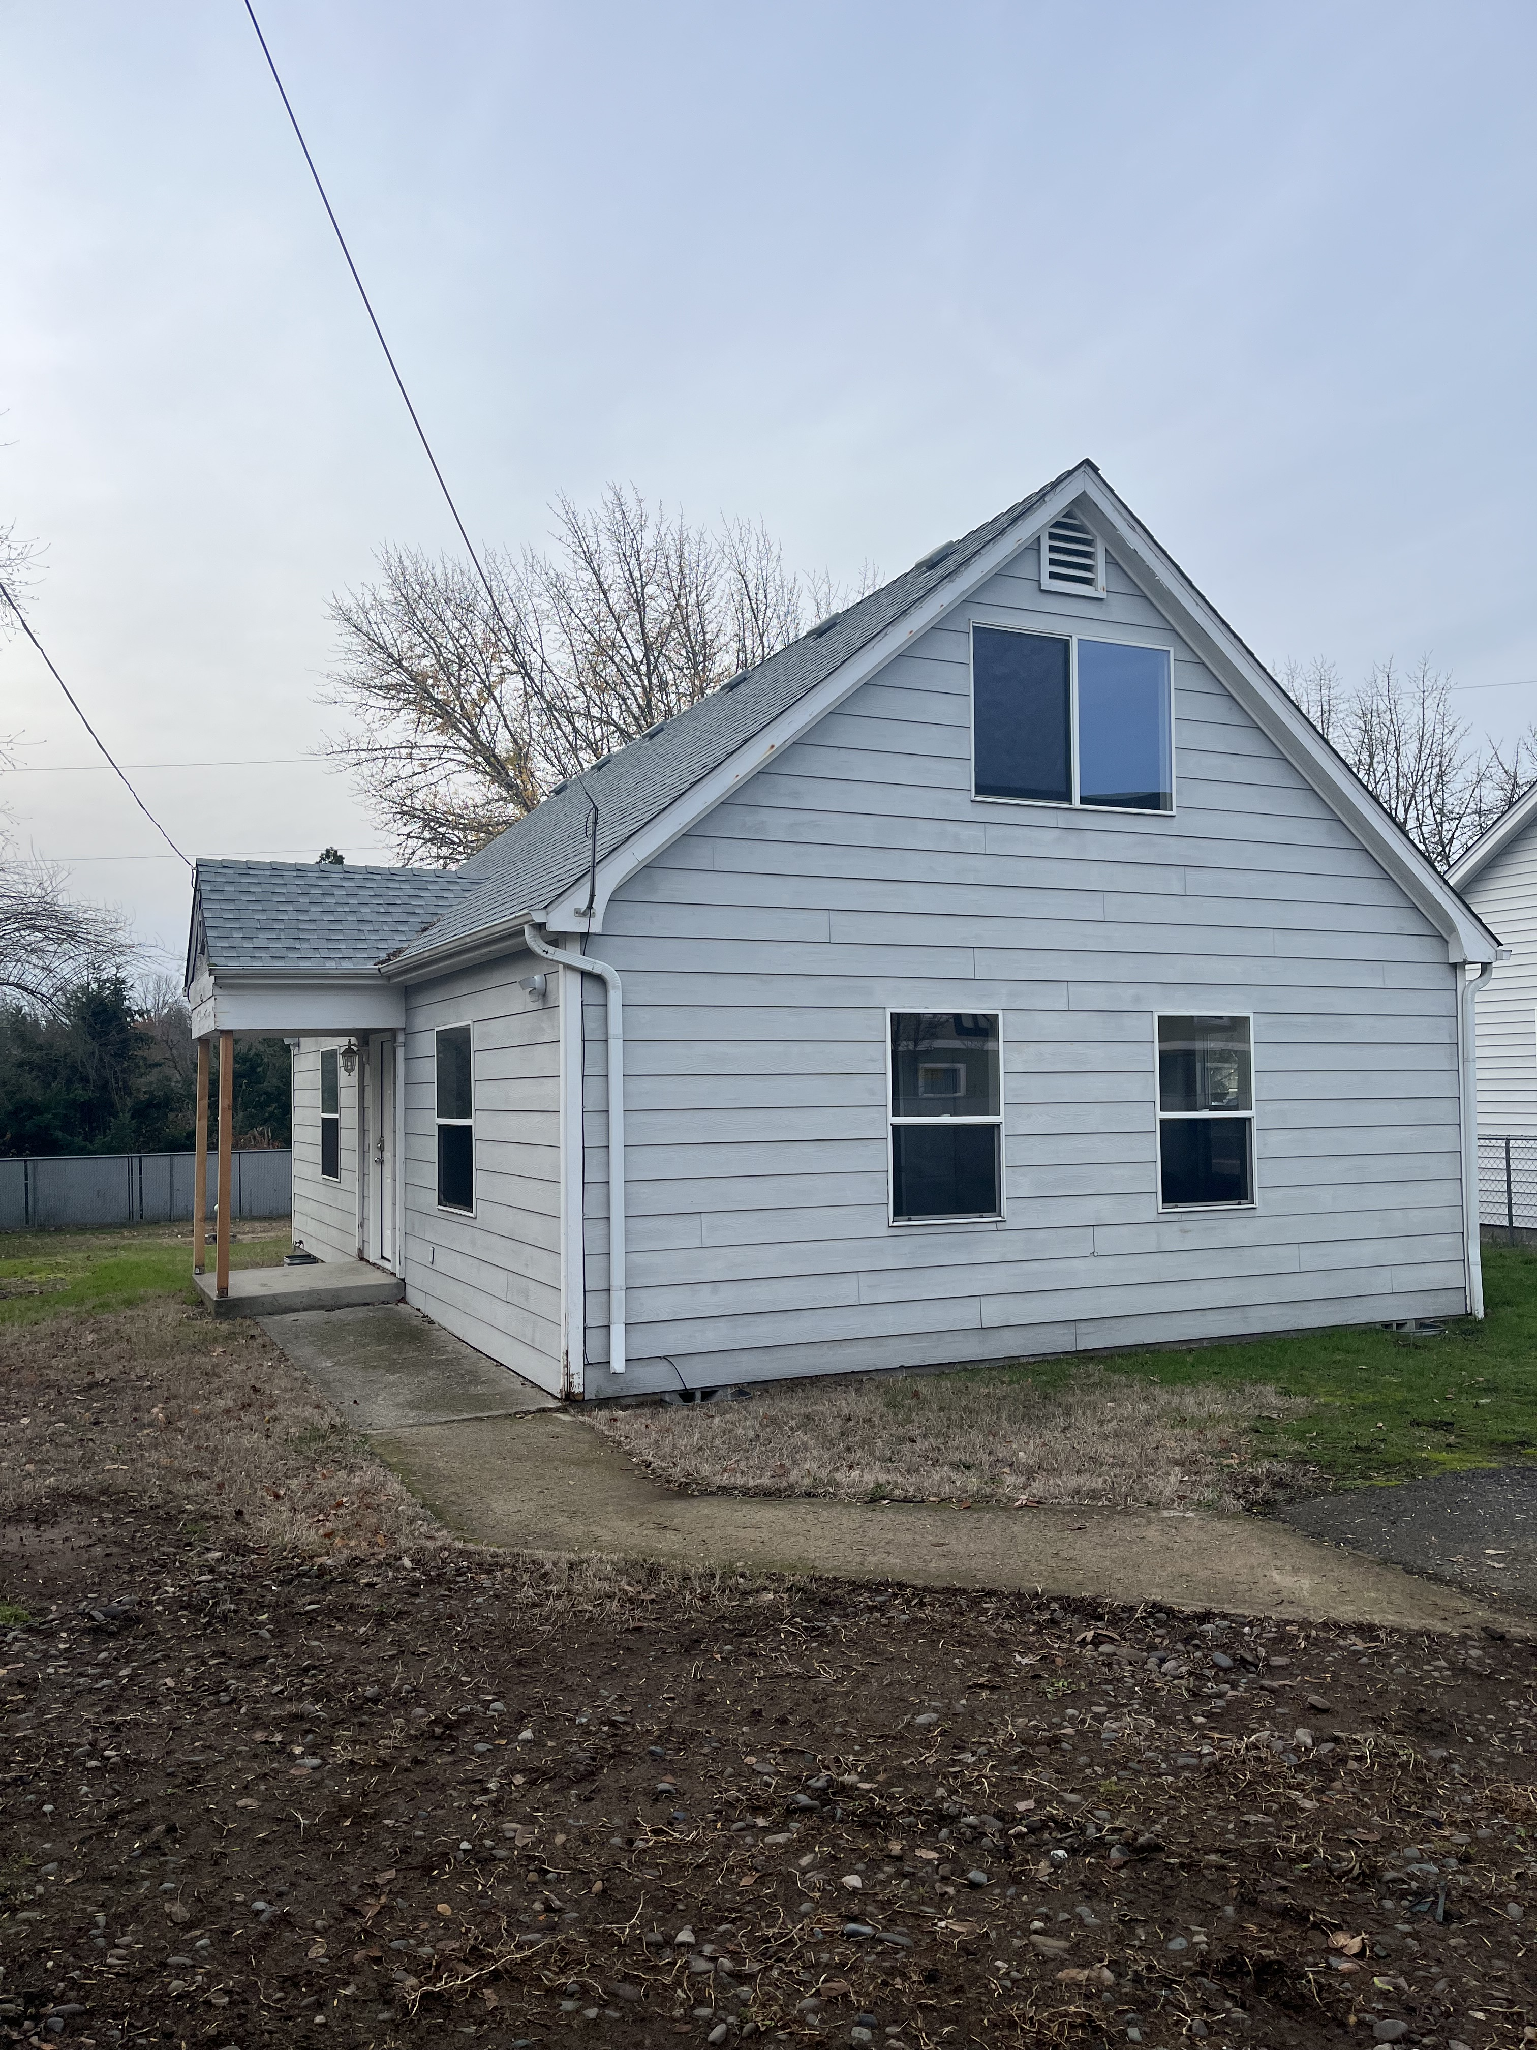
Objective 2: | Open a supportive housing program for transitional aged youth, 18-24, by the end of 2025
IN PROGRESS
Peace at Home is nearing completion of the Youth Housing Campus
Five rooms for transitional housing for people 18-24, with or without children.
A shared food pantry, gender inclusive clothing closet, and laundry facilities with community partners who have also leased part of this space for additional services.​
Photo courtesy of Thomas McGregor, Peace at Home Youth and Housing Project Manager
Priority area 1: IMPROVE INVOLVEMENT IN COMMUNITY HOUSING INITIATIVES TO IMPROVE ACCESSIBILITY, AFFORDABILITY, AND AVAILABILITY FOR MEMBERS WITH BEHAVIORAL HEALTH CONCERNS

Slide 43
Objective 3: | Increase the number of families sheltered through the Gary Leif Navigation Center by 10% by the end of Q4 in 2024​​.
COMPLETE
The Gary Leif Navigation center operates as a low barrier shelter/housing first option and directs community members to needed resources and services.
In 2024, 91 Families were served across four quarters
Quarter 1 | Quarter 2 | Quarter 3 | Quarter 4
23 | 32 | 23 | 13
Priority area 1: IMPROVE INVOLVEMENT IN COMMUNITY HOUSING INITIATIVES TO IMPROVE ACCESSIBILITY, AFFORDABILITY, AND AVAILABILITY FOR MEMBERS WITH BEHAVIORAL HEALTH CONCERNS

Slide 44

Intervention 3: | Increase Youth and Family-Centered Housing Resources
$10,000 granted to Tasha’s House
To support the purchase of a transport van for field trips and to safety drive youth home if they need a ride after using the resource center on the youth transitional housing campus.
Photo courtesy of Tasha’s house
Priority area 1: IMPROVE INVOLVEMENT IN COMMUNITY HOUSING INITIATIVES TO IMPROVE ACCESSIBILITY, AFFORDABILITY, AND AVAILABILITY FOR MEMBERS WITH BEHAVIORAL HEALTH CONCERNS

Slide 45
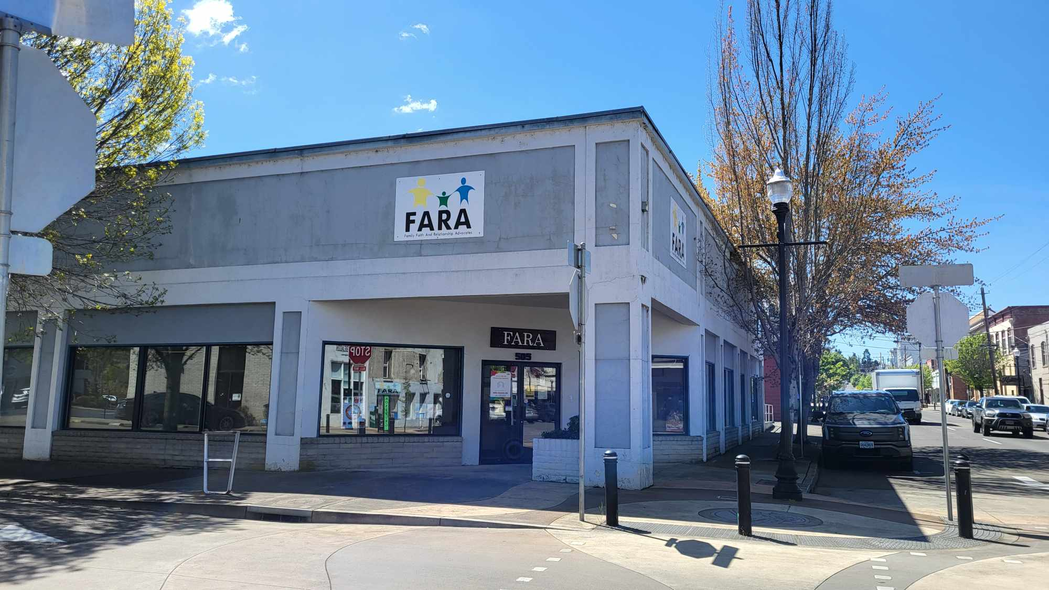
Community Engagement Activities
The 2023 - 2024 System of Care Grant contributed:
$35,000 to FARA's Homeless Youth Rural Outreach for backpack and winter clothing giveaway as well as back to school supplies. temporary shelter options for youth program and high school affinity group, and YES groups. The grant also supported their crisis/weekly drop-in center services.
$14,000 to Phoenix Schools’ EPIC Program to re-engage youth. The grant funded transportation, wages, housing, and childcare needs.
Photo courtesy of https://www.fara4kids.org/
Priority area 1: IMPROVE INVOLVEMENT IN COMMUNITY HOUSING INITIATIVES TO IMPROVE ACCESSIBILITY, AFFORDABILITY, AND AVAILABILITY FOR MEMBERS WITH BEHAVIORAL HEALTH CONCERNS

Slide 46
Community Engagement Activities
Events and Locations in which UH Community Health Workers actively engage with our community and offer Care Coordination Services:
Every Tuesday at the Navigation Center from 10AM-12PM​
The first Thursday of every month at ODHS from 10am-12pm​
The annual Point In Time (PIT) Homeless Count
Canvassing houselessness camps to offer supplies and support engagement in healthcare services.
Every Monday at the Roseburg Dream Center from 10AM-12PM​
Photo courtesy of Heather Carter, UH Care Navigation Manager-2024
Priority area 1: IMPROVE INVOLVEMENT IN COMMUNITY HOUSING INITIATIVES TO IMPROVE ACCESSIBILITY, AFFORDABILITY, AND AVAILABILITY FOR MEMBERS WITH BEHAVIORAL HEALTH CONCERNS

Slide 47
Community Engagement
Summary of 2024 CHP Activities
Convened CHP Steering Committee in January 2024
Gathering community input on key focus areas and related strategies
Held community meeting on April 18, 2024
Follow up community meeting on June 13, 2024
CHP Due to OHA by December 31, 2024

Slide 48
Equitable Access to Community Resources
$5,000
Umpqua Valley Rainbow Collective
LGBTQIA2+ Outreach expansion
$12,500
Friendly Kitchen Meals on Wheels
Promote food security and nutrition education
Secure housing,
Obtain ID’s and benefits,
Eliminate barriers to success
$32,000
Onward Roseburg
Conduct outreach to people experiencing
houselessness
Priority area 1: IMPROVE INVOLVEMENT IN COMMUNITY HOUSING INITIATIVES TO IMPROVE ACCESSIBILITY, AFFORDABILITY, AND AVAILABILITY FOR MEMBERS WITH BEHAVIORAL HEALTH CONCERNS

Slide 49
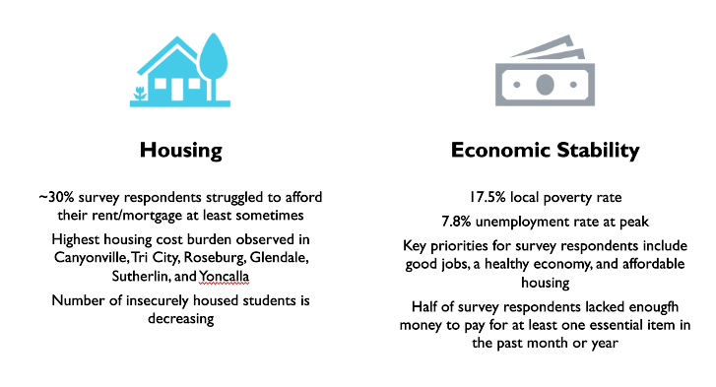
Health Equity Considerations for 2025
2023 Community Health Assessment Findings on Housing Needs
Priority area 1: IMPROVE INVOLVEMENT IN COMMUNITY HOUSING INITIATIVES TO IMPROVE ACCESSIBILITY, AFFORDABILITY, AND AVAILABILITY FOR MEMBERS WITH BEHAVIORAL HEALTH CONCERNS

Slide 50
Health Equity Considerations for 2025
From Our Community Health Assessment
Mental Health​
4.9 average mentally unhealthy days among adults​
42.7% of 11th graders reported depression symptoms​
One in five 11th graders and one in eight 6th and 8th graders self-reported suicidal ideation​
Substance Use Disorders​
One in five Douglas County residents aged 12 or older have a substance use disorder​
Drug-induced death rates more than doubled in Douglas County between 2016 and 2021​
Survey respondents identified addiction to stimulants, opioids, and alcohol as the top three contributors to health deterioration in the community.
Priority area 1: IMPROVE INVOLVEMENT IN COMMUNITY HOUSING INITIATIVES TO IMPROVE ACCESSIBILITY, AFFORDABILITY, AND AVAILABILITY FOR MEMBERS WITH BEHAVIORAL HEALTH CONCERNS

Slide 51
2024 Milestones
Quarter 1
MOU Executed with Adapt Integrated Health Care in December of 2023 to begin January 1st, 2024, to remodel and develop 52-unit hotel for transitional housing
Quarter 3
Quarter 2
Quarter 4:
Umpqua Innovation Conference scheduled for January of 2025 (modified conference cadence from fall of 2023)
Adapt Integrated Health Care begins the process of selecting a contractor for their Recovery Campus; 6 contractors in the running
Hillside Terrace occupancy at 100%
CHIP funding scheduled to be announced at the end of December 2024
Hosted Community Capacity Building Webinar in February 2024 to promote housing development
Hosted grant educational webinar May 2024 to support organizations in applying for UHA grant funding (including SHARE)
100% funding achieved for each development phase of the Adapt Recovery Campus
Adapt currently in the remodel phase of their 52-unit motel where UHA will have 10 beds for members with behavioral health needs in need of stable housing to promote safe discharge from Mercy Medical Center
CHA of 2023 concluded housing was a need within the SDoH (Priority Area 1)- Details listed in next slide
Priority area 1: IMPROVE INVOLVEMENT IN COMMUNITY HOUSING INITIATIVES TO IMPROVE ACCESSIBILITY, AFFORDABILITY, AND AVAILABILITY FOR MEMBERS WITH BEHAVIORAL HEALTH CONCERNS

Slide 52
Priority Area 1: Commentary
Goals for Next Year
Intervention 1: Strategic involvement with community partners, focusing on housing capacity developments ​
Attend all the Homeless Transition Action Group (HTAG) meetings and the LPSCC Behavioral Health & Housing Subcommittee Meetings in 2025 to increase strategic involvement with community partners.​
Gather information and updates during these meetings on housing capacity developments including urban campground development and promote the Share Application for increased potential funded housing opportunities.​
UHA will participate in the annual Point in Time Houseless count in January 2025.​
Socialize housing capacity development updates with the Behavioral Health Committee, at least once quarterly throughout 2025.​
Intervention 2: Increase investment in infrastructure development focused on housing for individuals with behavioral health needs​
Monitor the number of members with substance use disorders provided transitional housing through Adapts Lodge and promote the services within care coordination teams and community in 2025.​
Increase the capacity of Adapts Rodeway Project for individuals experiencing behavioral health concerns and in need of transitional housing, by adding 10 beds by the end of 2025.​
Implement quarterly tracking and monitoring of the number of members with behavioral health needs receiving Housing-Related HRS. Looking to identify trends and opportunities for improvement in housing support services.​
Intervention 3: Increase youth and family-centered housing resources ​
Monitor the number of families sheltered through the Gary Leif Navigation Center in 2025.​
Monitor the family occupancy of Hillside Terrace in 2025.​
Monitor utilization of the supportive housing program for transitional aged youth, 18-24 in 2025.​
Promote behavioral health housing in HRSN provider recruitment.
Many of the interventions set within priority area 1 were achieved between 2024-2025, these completed interventions have been re-evaluated and updated to reflect ongoing population-specific needs.
Priority area 1: IMPROVE INVOLVEMENT IN COMMUNITY HOUSING INITIATIVES TO IMPROVE ACCESSIBILITY, AFFORDABILITY, AND AVAILABILITY FOR MEMBERS WITH BEHAVIORAL HEALTH CONCERNS

Slide 53
Priority Area 2
INCREASE CONTINUUM OF CARE AND COMMUNITY CAPACITY TO PROVIDE TREATMENT AT HIGHER LEVELS OF CARE

Slide 54
Intervention 1: Decrease inappropriate use of emergency departments for individuals with behavioral health needs​
Intervention 2: Increase array of behavioral health services available to treat individuals in need of higher levels of care​
Intervention 3: Incentivize providers to improve quality of care and responsiveness to acute, urgent, and emergent behavioral health needs​
Intervention 4: Increase capacity of youth-serving programs to offer higher intensity outpatient treatment services​
Intervention 5: Continue to expand collection of infographics and resource/guides on pathways to treatment and available services/programs for 2024
IN PROGRESS
COMPLETE
COMPLETE
IN PROGRESS
COMPLETE
Priority Area 2: Increase continuum of care and community capacity to provide treatment at higher levels of care

Slide 55
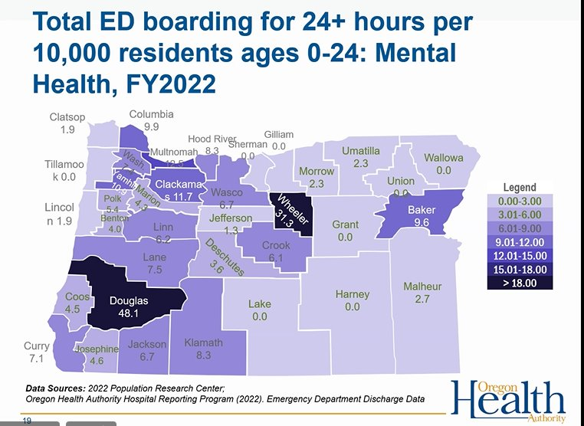
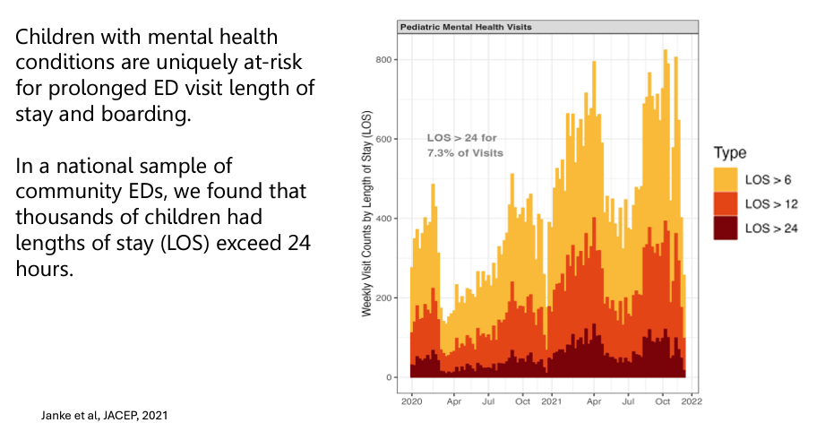
Objective 1: | Reduce Emergency Department Boarding for children and young adults through tracking and monitoring of ED Boarding metrics using specifications from the Oregon Hospital Reporting Program
IN PROGRESS
Data from University of Michigan, Oregon Health Authority September 2024 Presentation of Emergency Department Boarding
Priority Area 2: Increase continuum of care and community capacity to provide treatment at higher levels of care

Slide 56
Objective 1: | Reduce Emergency Department Boarding for children and young adults through tracking and monitoring of ED Boarding metrics using specifications from the Oregon Hospital Reporting Program
IN PROGRESS
  Data shown is generated from Point Click Care between April 2024-December 2024. Average time spent (hours) in ED:
    Children for birth to five: 2.89 hours
    Individuals ages six and older: 23.75 hours
Data from PointClickCare, UHA Metric Developed in 2024 to Calculate Time Spent in the Emergency Department
Priority Area 2: Increase continuum of care and community capacity to provide treatment at higher levels of care

Slide 57
Objective 1: | Reduce Emergency Department Boarding for children and young adults through tracking and monitoring of ED Boarding metrics using specifications from the Oregon Hospital Reporting Program
IN PROGRESS
Data from PointClickCare, UHA Metric Developed in 2024 to Calculate Time Spent in the Emergency Department
Priority Area 2: Increase continuum of care and community capacity to provide treatment at higher levels of care

Slide 58
Objective 2: | Reduce emergency department readmissions rate for individuals with behavioral health conditions by at least 10% in 2024.​
IN PROGRESS
Priority Area 2: Increase continuum of care and community capacity to provide treatment at higher levels of care

Slide 59
Objective 2: | Reduce emergency department readmissions rate for individuals with behavioral health conditions by at least 10% in 2024.​
IN PROGRESS
IIBHT
Members < 18 that had 2 or more ED visits and/or residential stays within 180 days of an IIBHT service.
Wraparound
Members < 18 that had 1 or more ED visits and/or residential stays within 180 days of wrap service.
Assertive Community Treatment
Members 18+ that had 1 or more ED visits within 180 days of wrap service.
Supported Employment
Members < 18 that had 1 or more ED visits within 180 days of wrap service.
  UH amended Adapt’s contract in 2024, introducing new Value Based Payment and Quality Metrics focused on Emergency Department diversion within fidelity programs (IIBHT, Wraparound, ACT, Support Employment).
  We increased metric targets after conducting a year over year performance analysis, which demonstrated consistent achievement between 95% - 100%.
Priority Area 2: Increase continuum of care and community capacity to provide treatment at higher levels of care

Slide 60
Objective 2: | Reduce emergency department readmissions rate for individuals with behavioral health conditions by at least 10% in 2024.​
IN PROGRESS
Priority Area 2: Increase continuum of care and community capacity to provide treatment at higher levels of care

Slide 61
Objective 3: | Increase the number of members served at the Sobering Center by at least 10%.
COMPLETE
12% more members served
Services Included:
  Food Services
  Peer Services
  Case Management
Items Provided:
  Food Items
  Liquid
  Laundry
  Clothing
  Hygiene Kit
  Tarp
  Tent
  Sleeping Bag
  Naloxone
  Wood Care Kit
Year | Individuals Served
2023 | 113
2024 | 127
Priority Area 2: Increase continuum of care and community capacity to provide treatment at higher levels of care

Slide 62
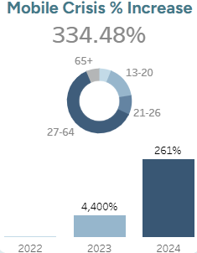
Objective 4: | Increase number of members served by the mobile crisis response team by 20%
COMPLETE
Priority Area 2: Increase continuum of care and community capacity to provide treatment at higher levels of care

Slide 63
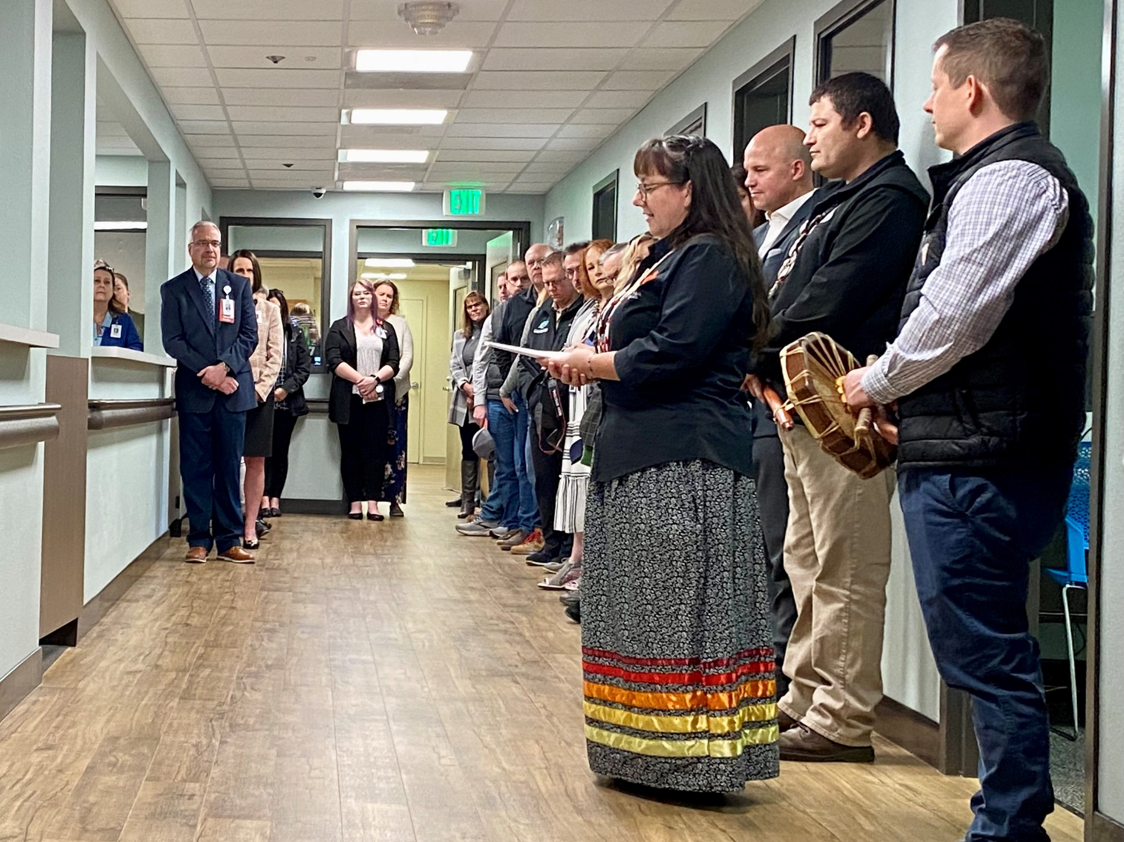
Intervention 1: | Decrease Inappropriate Use of Emergency Departments Among Individuals with Behavioral Health Needs
January 23, 2024, Mercy Medical Center Opened their Behavioral Health Unit, expanding inpatient adult behavioral health services by 12-beds
The Cow Creek Band of Umpqua Tribe of Indians donated $150,000 to Mercy Medical Center’s Behavioral Health Unit to expand access to services across southern Oregon
Photo courtesy of the Cow Creek Band of Umpqua Tribe of Indians
Priority Area 2: Increase continuum of care and community capacity to provide treatment at higher levels of care

Slide 64
Intervention 2: | Increase Array of Behavioral Health Services Available to Treat Individuals in Need of Higher Levels of Care
COMPLETE
IN PROGRESS
Monitor the number of members utilizing SUD residential and withdrawal management services with a goal to increase their utilization by 10% compared to 2023. ​
Record the number of SUD affected members serviced by the Recovery Lodge and increase participation by at least 10% compared to 2023.
Priority Area 2: Increase continuum of care and community capacity to provide treatment at higher levels of care

Slide 65
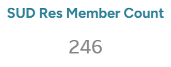
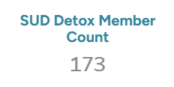
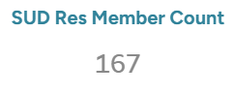
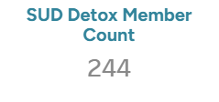
Objective 1: | Monitor the number of members utilizing SUD residential and withdrawal management services with a goal to increase their utilization by 10% compared to 2023.
COMPLETE
July 2023 to December 2023
January 2024 to October 2024
419 Members Served
411 Members Served
Priority Area 2: Increase continuum of care and community capacity to provide treatment at higher levels of care

Slide 66
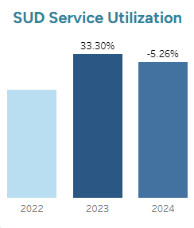
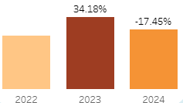
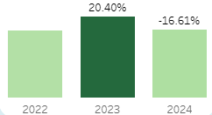
Objective 2: | Monitor the number of members utilizing SUD residential and withdrawal management services with a goal to increase their utilization by 10% compared to 2023.
COMPLETE
Residential and Withdrawal Management Services for Substance Use Disorder have Declined in 2024, as compared to service rates in 2023.
Priority Area 2: Increase continuum of care and community capacity to provide treatment at higher levels of care

Slide 67
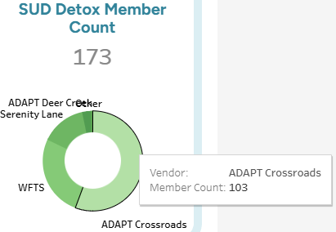
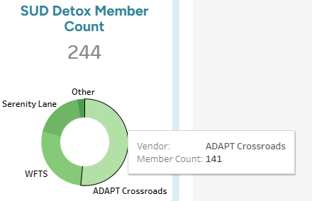
Objective 3: | Record the number of SUD affected members serviced by the Recovery Lodge and increase participation by at least 10% compared to 2023.
IN PROGRESS
July 2023 to December 2023
January 2024 to October 2023
Priority Area 2: Increase continuum of care and community capacity to provide treatment at higher levels of care

Slide 68
Intervention 3: | Incentivize Providers to Improve Quality of Care and Responsiveness to Acute, Urgent, and Emergent Behavioral Health Needs
Monitor use of ED Diversion metrics in provider contracts each quarter in 2024.​
Track the quality-of-care performance in all contracted practices with ED-related quality metrics, for a 10% improvement.​
Offer behavioral health providers utilization of UHA’s analytics software, aiming to improve treatment outcomes, in 2024.​
Implement an incentive program that providers reporting REAL+D and SDOH data, increasing reporting by 20% in 2024.
COMPLETE
COMPLETE
IN PROGRESS
COMPLETE
Priority Area 2: Increase continuum of care and community capacity to provide treatment at higher levels of care

Slide 69
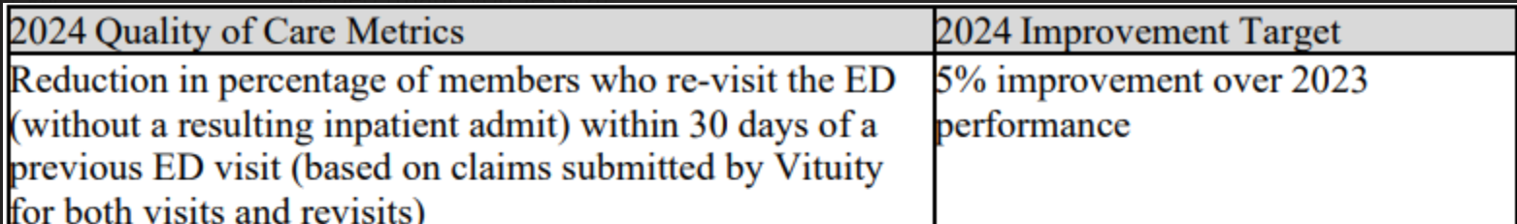
Objective 1: | Monitor use of ED Diversion metrics in provider contracts each quarter in 2024
COMPLETE
UHA has two providers with ED Diversion metrics within their contracts
We amended Adapt’s contract in 2024, introducing 3 new value-based payment metrics for IIBHT, ACT, & Wraparound.
Vituity (ED Care Navigators)
Vituity (Rely Health) Metric
Priority Area 2: Increase continuum of care and community capacity to provide treatment at higher levels of care

Slide 70
Objective 2: | Track quality-of-care performance in all contracted practices with ED-related quality metrics, for a 10% improvement.
COMPLETE
We began tracking provider performance on ED-related quality metrics in 2024 for our CBHP.
Vituity reported a 1.90% increase in emergency department readmissions between 2023 and 2024.
Priority Area 2: Increase continuum of care and community capacity to provide treatment at higher levels of care

Slide 71
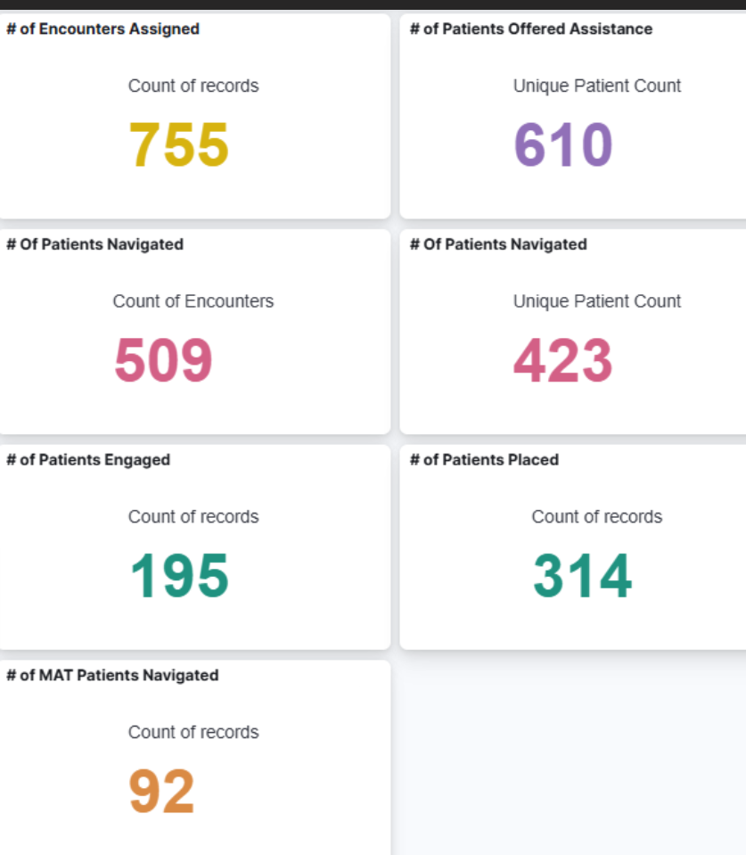
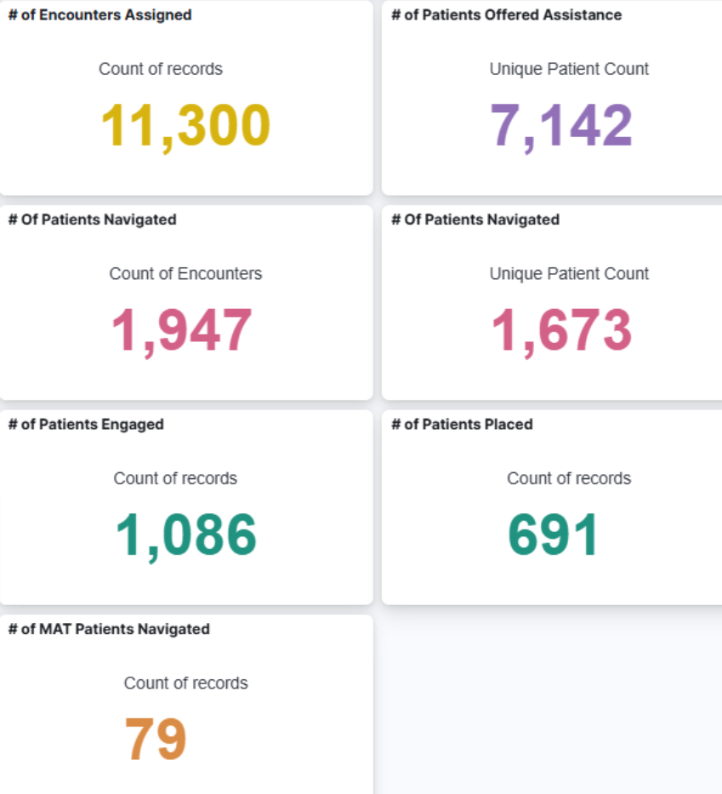
Objective 2: | Track quality-of-care performance in all contracted practices with ED-related quality metrics, for a 10% improvement.
COMPLETE
July 2023 to December 2023
January 2024 to October 2023
Vituity (Rely Health) ED Navigator data from members followed after their emergency department visit
Priority Area 2: Increase continuum of care and community capacity to provide treatment at higher levels of care

Slide 72
Objective 3: | Offer behavioral health providers utilization of UHA’s analytics software, aiming to improve treatment outcomes, in 2024.
IN PROGRESS
Received legal consultation to begin drafting a blanket Release of Information in accordance with updated 42. CFR P2.
In 2025, we plan to integrate behavioral health providers as new users into our health plan provider portal (UHBI). These new users will include mental health and substance use disorder treatment providers. Integrating these providers will support health plan quality measure performance improvement by facilitating behavioral health provider engagement in quality improvement activities, such as measure gap closure.
Priority Area 2: Increase continuum of care and community capacity to provide treatment at higher levels of care

Slide 73
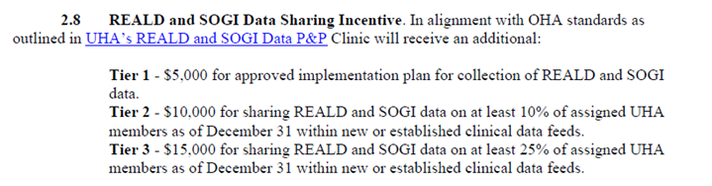
Objective 4: | Implement an incentive program for providers reporting REAL+D and SDOH data, increasing reporting by 20% in 2024.
COMPLETE
Implemented tiering system for Health Information Technology (HIT) Incentive Program in 2024 This pays providers $5K, $10K, or $15K based on the percentage of members that the clinic provides UH REALD/SOGI data.
Priority Area 2: Increase continuum of care and community capacity to provide treatment at higher levels of care

Slide 74
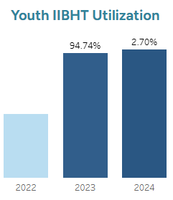
Objective 5: | Increase the number of youth receiving IIBHT by 10 by the end of Quarter 4, 2024
IN PROGRESS
Adapt’s IIBHT Program Faced Provider Recruitment and Retention Challenges in 2024
Despite these challenges, the program has still increased the total number of youth served each calendar year since 2019.
Priority Area 2: Increase continuum of care and community capacity to provide treatment at higher levels of care

Slide 75
Objective 6: | Continue to Expand Collection of Infographics and Resource Guides on the Pathways to Treatment and Available Services
COMPLETE
12 New Infographics Created ​
Child Growth Milestones (English & Spanish)​
Well-Child Visits (English & Spanish)​
Social-Emotional Services Bike Route​
Social Emotional Services For Children 0-5 (Overview & Umpqua Health Network Offerings)​
4 New Resource Guides Created​
Clinical Practice Guidelines Submission Form & Review Process
Eating Disorder Discussion TIP Sheets (Providers & Physicians)
Disordered Eating Consultation Services
Young Children Workforce Development Scholarship Program Dashboards (Primary Care, Integrated Behavioral Health and Specialty Behavioral Health)
Young Children Workforce Development Scholarship Program Flyers (Primary Care, Integrated Behavioral Health and Specialty Behavioral Health)
Douglas System of Care Barrier Resolution Process
Umpqua Health 2024 Information Flyer
EPSDT for Members Flyer
Helpful Information for You and Your Baby
Umpqua Health Social Emotional Asset Maps​
Specialty Behavioral Health​
Integrated Behavioral Health​
Community-Based Organizations
Douglas System of Care Children and Youth Barrier Submission (New SmartSheet)
Priority Area 2: Increase continuum of care and community capacity to provide treatment at higher levels of care

Slide 76

Community Engagement Activities
On November 14, 2024, Umpqua Health hosted the 2024 Annual Community Meeting at Umpqua Community College, focused on young children’s (birth to five) social emotional health: Building Strong Foundations: Investing in Resilient Futures.
    Over forty individuals participated in this event from various child and family-serving systems including early childhood learning, integrated behavioral health and specialty behavioral health.
    Umpqua Health reported on findings from data analysis, asset mapping, and progress made toward action plan goals, including education on 2025 metric changes..
Priority Area 2: Increase continuum of care and community capacity to provide treatment at higher levels of care

Slide 77
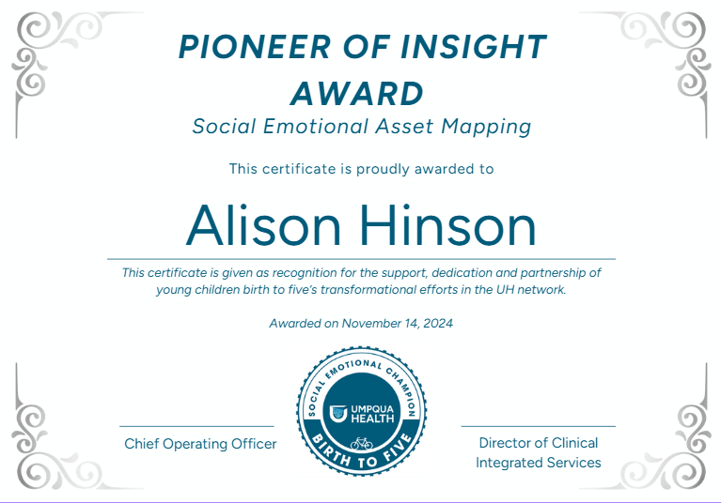
Community Engagement Activities
Umpqua Health recognized key Social Emotional Champions for their support, dedication, and partnership in improving social emotional services within our community for young children birth this year:
Pioneer of Insight Award: Alison Hinson
Proactive Excellence Award: Rebecca Moyer
Whole Health Champion Award: Heather Holmes, Rodney Todd, Rachelle Wells
Compassionate Care Champion Awards: Adapt Primary Care, Family Development Center, Juniper Tree Counseling
Priority Area 2: Increase continuum of care and community capacity to provide treatment at higher levels of care

Slide 78
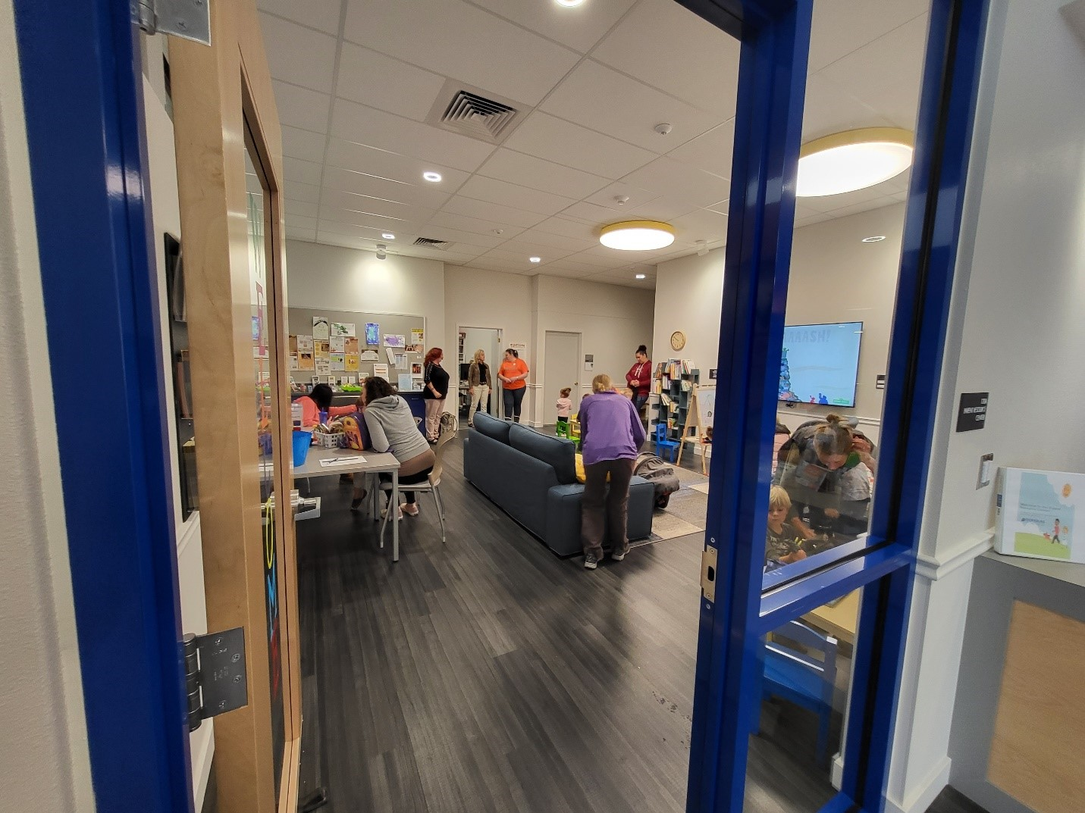
Community Engagement Activities
Adapt was granted $6,000 to purchase incentives individuals participating in their Opioid Treatment Program. This included $100 gift cards for up to 60 individuals.
YMCA-Camp Connections was granted $10,000 to organize and run a free 8-week summer camp for youth 8-12 with a focus on mindfulness and connections.
Phoenix School of Roseburg/Creating Community Resilience was granted $5,000 to implement 5-6 wellness events in 2023.
Friends of Roseburg Public Library was granted $5,000 to provide free, age-appropriate books monthly to youth participants in the service area through Dolly Parton’s Imagination Library.
Adapt was granted funds to support suicide prevention education to adults and community partners.
Early Learning and Parent Resource Center at Douglas ESD was granted funds to purchase activities for playgroups, arts and crafts, music and movement, STEAM, etc.
SHARE Investment Reporting. (2023). [Photograph].
Priority Area 2: Increase continuum of care and community capacity to provide treatment at higher levels of care

Slide 79

Equitable Access to Behavioral Health Services
UH awarded CHIP funding:
System of Care awarded funding:
$22,500 to FEATT to provide I/DD trainings for parents and community partners.
$4,500 to Douglas CARES to provide a two-day “Strengthening Families” training to Douglas CARES and DESD staff. This included blended funding across all partner organizations totaling $11,320.00.
$22,500 to Douglas ESD to develop LGBTQIA+ and BIPOC Affinity Groups
$2,820 to Peace at Home for culturally specific services for Latinx Survivors of domestic violence to increase awareness and access through outreach. Additionally, they provided support groups, focusing on healthy relationships, healing from trauma and recognizing resilience.
Priority Area 2: Increase continuum of care and community capacity to provide treatment at higher levels of care

Slide 80

Equitable Access to Behavioral Health Services
Health Care Interpreter Scholarship Program
UHA launched a scholarship program to increase language access for OHP members by covering the costs of training and exams for health care professionals to become a qualified or certified health care interpreter.
Approved applicants received funding for the Oregon Health Care Interpreter Association’s (OHCIA) 60-hour online HCI training. ​
Scholarship Prerequisites​
  18 years or older​
  Graduate from high school (or GED equivalent)​
  Work or plan to work in Douglas County​
  Absent from the Medicaid Exclusion List​
  Proof of English and target language proficiency​
Priority Area 2: Increase continuum of care and community capacity to provide treatment at higher levels of care

Slide 81
Equitable Access to Behavioral Health Services
Health Care Interpreter Scholarship Program
12 applicants received HCI Scholarships from Umpqua Health in 2024:
5 are now on the Oregon HCI registry
3 Spanish
7 completed training and are pending registry approval
4 Spanish
2 applicants are from a behavioral health organization and offer in-language counseling
4 applicants are from a behavioral health integrated clinic
1 Hindi
1 ASL
3 ASL
Priority Area 2: Increase continuum of care and community capacity to provide treatment at higher levels of care

Slide 82

Equitable Access to Behavioral Health Services
UH conducted asset mapping of social emotional services available to young children birth to age 5 within our provider networking, focusing on:
          Integrated Behavioral Health,
      Specialty Behavioral Health and
      Community Organizations (new for 2024)
      Information collected included hours of operations, format of services, languages of services provided, ethnicity and gender identify of providers location of practices, etc.
      Asset maps were published on the UH website within the provider directory and shared at our annual community social emotional health meeting in November 2024.
Priority Area 2: Increase continuum of care and community capacity to provide treatment at higher levels of care

Slide 83
2024 Milestones
Quarter 1
Conducted collaborative meetings with OHA’s CFBH Team and Adapt focused on MRSS, IIBHT and Wraparound program leadership to decrease youth/adolescent Emergency Department boarding​
Quarter 2
Adapt Integrated Healthcare recruits clinician to fully staff MRSS program
Request ED Boarding metric specifications from the Oregon Hospital Reporting Program
Quarter 3
Created developmental milestones and recommended visit magnets in English and Spanish
Quarter 4:
Children’s Social Emotional Health Asset Maps published and distributed with the community
Adapt provided education about Wraparound to UHA Behavioral health care coordinators to promote referrals
Douglas County Resource Guide published and distributed throughout community
Douglas County Resource guide updated in February
Adapt loses IIBHT therapist, leaving program with one therapist and two skills trainers
Priority Area 2: Increase continuum of care and community capacity to provide treatment at higher levels of care

Slide 84
2024 Milestones
COMPLETE
UH Implemented Quarterly Monitoring of the Following: ​
Tracking Adapt Integrated Health Care Campus Expansion ​
Monitoring utilization of Withdrawal Management (Detox) and Residential Substance Use Disorder treatment services​
Monitoring Emergency Department readmissions for individuals with behavioral health conditions​
Tracking the number of members served at the Sobering Center​
Monitoring Mobile Crisis utilization.​
Tracking the number served by the Recovery Lodge
Priority Area 2: Increase continuum of care and community capacity to provide treatment at higher levels of care

Slide 85
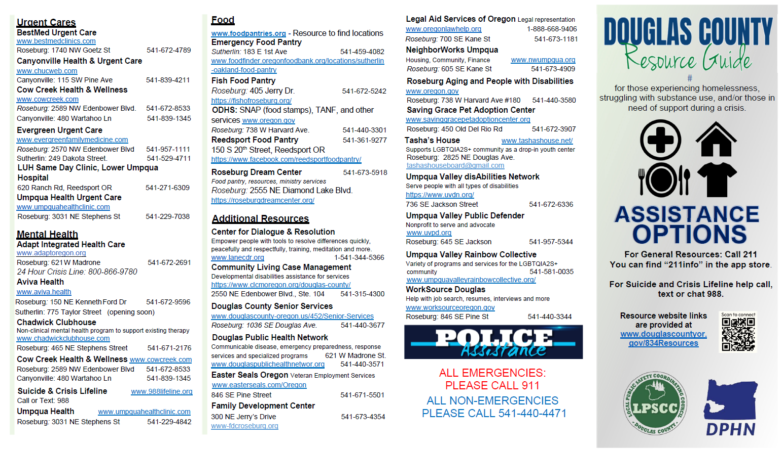
2024 Milestones
COMPLETE
Development and publication of a comprehensive behavioral health community resource guide available on UHA's website
        Full Resource Guide is available on this site: https://acrobat.adobe.com/id/urn:aaid:sc:va6c2:520d75d0-e7a5-477f-8ed5-5ea1a1357b19.
Priority Area 2: Increase continuum of care and community capacity to provide treatment at higher levels of care

Slide 86
Priority Area 2: Commentary
Many of the interventions set within priority area 1 were achieved between 2024-2025; these completed interventions have been re-evaluated and updated to reflect ongoing population-specific needs.
Intervention 1: Decrease inappropriate use of emergency departments for individuals with behavioral health needs​
Reduce emergency department readmissions rate for individuals with behavioral health conditions by at least 2% in 2025.​
Increase the number of members served at the Sobering Center by at least 10%.​
Increase number of members served by the mobile crisis response team by 20% ​
Intervention 2: Increase array of behavioral health services available to treat individuals in need of higher levels of care​
Monitor the number of members utilizing SUD residential and withdrawal management services with a goal to increase their utilization by 10% compared to 2024.​
Record the number of SUD affected members serviced by the Recovery Lodge and increase participation by at least 10% compared to 2025.​
Intervention 3: Incentivize providers to improve quality of care and responsiveness to acute, urgent, and emergent behavioral health needs​
Monitor use of ED Diversion metrics in provider contracts each quarter in 2025.​
Track the quality-of-care performance in all contracted practices with ED-related quality metrics, for a 10% improvement.​
Offer behavioral health providers utilization of UHA’s analytics software, aiming to improve treatment outcomes, in 2025.​
Implement an incentive program that providers reporting REAL+D and SDOH data, increasing reporting by 20% in 2025.​
Intervention 4: Increase capacity of youth-serving programs to offer higher intensity outpatient treatment services​
Increase the number of youth receiving IIBHT by 10% by the end of Quarter 4, 2025. ​
Update the social-emotional asset map for children aged birth to five to include community-based organizations.​
Publish 8 comprehensive infographics detailing available services and pathways to increase user understanding and engagement.​
Intervention 5: Continue to expand collection of infographics and resource/guides on pathways to treatment and available services/programs for 2025​
Priority Area 2: Increase continuum of care and community capacity to provide treatment at higher levels of care

Slide 87
Priority Area 3
INCREASE AVAILABILITY OF BEHAVIORAL HEALTH SERVICES THROUGH WORKFORCE DEVELOPMENT BY ENGAGING COMMUNITY STAKEHOLDERS TO CREATE, PROMOTE, AND SUPPORT EDUCATION & TRAINING INITIATIVES.

Slide 88


Priority Area 3: | Increase availability of behavioral health services through workforce development by engaging community stakeholders to create, promote, and support education & training initiatives
Intervention 1: Increase access to peer delivered services for individuals with behavioral health needs​
Intervention 2: Enhance provider capacity to treat eating disorders through partnership with Willamette Nutrition Source ​
Intervention 3: Increase local training and education opportunities to expand access to evidence-based treatment modalities​
Intervention 4: Increase the cultural and linguistic diversity of contracted behavioral health providers​
Intervention 5: Develop and promote workforce development, training, and educational opportunities for current and aspiring behavioral health professionals.
COMPLETE
IN PROGRESS
COMPLETE
COMPLETE
COMPLETE
Priority Area 3: Increase behavioral health service availability through workforce development​

Slide 89


Intervention 1: | Increase Access to Peer Delivered Services for Individuals with Behavioral Health Needs
Increase contracted behavioral health peer delivered service providers by 10% in 2024​
Increase utilization of behavioral health peer delivered services by 2% in 2024​
Increase the number of practices that employ peer delivered services in 2024.
COMPLETE
COMPLETE
COMPLETE
Priority Area 3: Increase behavioral health service availability through workforce development​

Slide 90

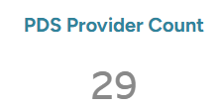
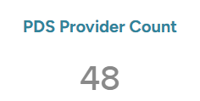
Objective 1: | Increase contracted behavioral health peer delivered service providers by 10% in 2024​
COMPLETE
July 2023-December 2023
January 2024 – October 2024
Priority Area 3: Increase behavioral health service availability through workforce development​

Slide 91
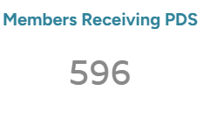
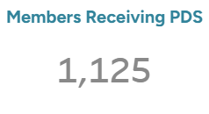
Objective 2: | Increase utilization of behavioral health peer delivered services by 2% in 2024
COMPLETE
89% Increase in Total Number of Members Receiving Peer Delivered Services
July 2023-December 2023
January 2024 – October 2024
Priority Area 3: Increase behavioral health service availability through workforce development​

Slide 92
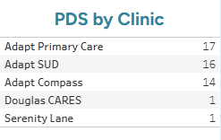
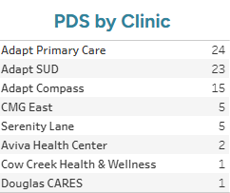
Objective 3: | Increase the number of practices employing peer delivered service providers in 2024
COMPLETE
July 2023-December 2023
Umpqua Health recruited a new Traditional Health Worker Liaison in 2024.
All UH-Employed Community Health Workers will apply for personal health Navigator Certifications in 2025
January 2024 – October 2024
Priority Area 3: Increase behavioral health service availability through workforce development​

Slide 93
Intervention 2: | Enhance Provider Capacity to Treat Eating Disorders Through Partnership with Willamette Nutrition Source
IN PROGRESS
COMPLETE
Begin monitoring utilization of eating disorder consultation; increase contracted provider utilization of eating disorder consultation with Willamette Nutrition Source by 3%.​
Monitor the number of members treated for eating disorders and target outreach to the top five (5) providers treating easting disorders to provide education on the consultation resources available
Priority Area 3: Increase behavioral health service availability through workforce development​

Slide 94


Objective 1: | Begin monitoring utilization of eating disorder consultation; increase contracted provider utilization of eating disorder consultation with Willamette Nutrition Source by 3%.
IN PROGRESS
Utilization for 2024 was 0%, but efforts to increase utilization of these consultation services included the following plans:
Educational presentation during Behavioral Health Subcommittee completed in early 2024.
Created and distributed educational flyers on these services in Quarter 2 of 2024.
Develop a distribution plan for flyers across organizations identified as serving patients with eating disorders (planned for 2025)
Developing eating disorder training videos (planned for 2025)
Priority Area 3: Increase behavioral health service availability through workforce development​

Slide 95
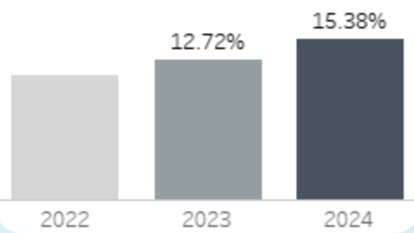
Objective 2: | Monitor the number of members treated for eating disorders and target outreach to the top five (5) providers treating eating disorders to provide education on the consultation resources available
COMPLETE
  The top 5 providers treating eating disorders in 2023 were: Mercy Medical Center Roseburg, Carlynn Mcinerny, Amber Wright, Michael Bigham, and Elizabeth Sunzeri
  Top 5 providers treating eating disorders in 2024 were: Mercy Medical Center Roseburg, Elizabeth Sunzeri, Susan Hibss, Elizabeth Boggio, and Amber Miller
Count of Distinct Members Diagnosed with an Eating Disorder
Priority Area 3: Increase behavioral health service availability through workforce development​

Slide 96
Intervention 2: | Increase Local Training and Education Opportunities to Expand Access to Evidence-Based Treatment Modalities
Increase provider's utilization of eating disorder consultation by 50% in 2024​
Solicit provider feedback on desired training topics and host at least one prioritized training topic each quarter in 2024, through the Behavioral Health Subcommittee.​
Incentivize provider engagement in trainings designed to enhance social emotional services for young children. Train at least 5 providers through Social Emotional Workforce Development Incentive Program by the end of Q4 2024
IN PROGRESS
COMPLETE
COMPLETE
Priority Area 3: Increase behavioral health service availability through workforce development​

Slide 97
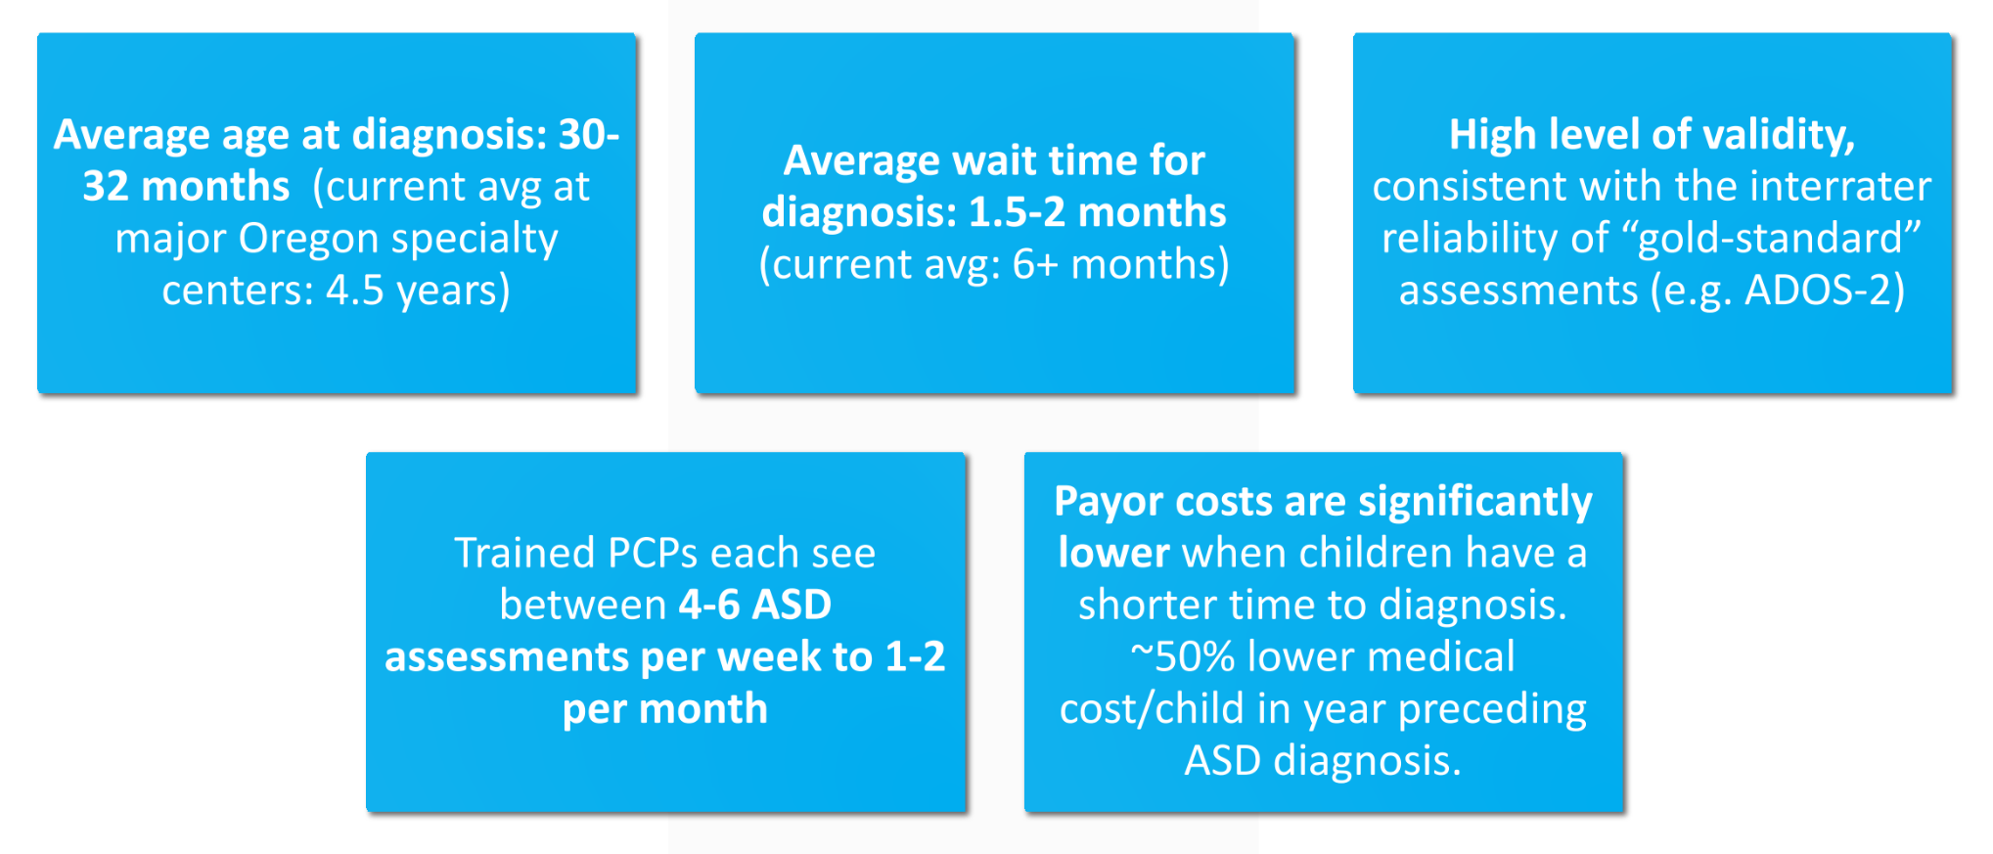
Objective 1: | Solicit provider feedback on desired training topics and host at least one prioritized training topic each quarter in 2024, through the Behavioral Health Subcommittee.
COMPLETE
Autism Assessment Training Interest poll distributed within the Behavioral Health Subcommittee in September 2024:
Through partnership with other CCOs in Southern Oregon, UH plans to train 9 primary care providers, which will increase local capacity in identifying and treating Autism.
Priority Area 3: Increase behavioral health service availability through workforce development​

Slide 98

Objective 1: | Solicit provider feedback on desired training topics and host at least one prioritized training topic each quarter in 2024, through the Behavioral Health Subcommittee.
COMPLETE
March 2024: Best Practices for Alcohol Use Disorder by Dr. Eleasa Sokolski, MD, OHSU
April 2024: Eating Disorders and Disordered Eating and Related Eating Issues by Therese Waterhous, PHD, Certified Eating Disorder Specialist, Fellow, Academy of Eating Disorders from Willamette Nutrition Source
June 2024: Cannabis Use in Pregnancy and Breastfeeding by Dr. Jamie Lo, MD, MCR, Associate Professor, OHSU's Department of Obstetrics & Gynecology
October 2024: Introduction to Gender Affirming Care by Amy Lenkin, LCSW, OHSU Transgender Health Program
Priority Area 3: Increase behavioral health service availability through workforce development​

Slide 99
Intervention 4: | Increase the Cultural and Linguistic Diversity of Contracted Behavioral Health Providers
Increase number of behavioral health providers with REAL+D and SOGI data by 50% in 2024​
Develop consent process for UHA to obtain contracted behavioral health provider’s demographic question responses provided in Healthcare Workforce Reporting Survey issued by licensure boards by Q2 2024​
Conduct biannual assessment of contracted behavioral health provider’s REAL+D & SOGI data beginning Q2 2024​
Evaluate cultural and linguistic responsiveness of contracted behavioral health provider panel by comparing provider to member demographics, report findings to the Behavioral Health Subcommittee by Q4 2024
IN PROGRESS
COMPLETE
IN PROGRESS
COMPLETE
Priority Area 3: Increase behavioral health service availability through workforce development​

Slide 100
Objective 1: | Increase number of behavioral health providers with REAL+D and SOGI data by 50% in 2024
IN PROGRESS
  Implemented tiering system for Health Information Technology (HIT) Incentive Program in 2024
  This pays providers $5K, $10K, or $15K based on the percentage of members that the clinic provides UH REALD/SOGI data.
Priority Area 3: Increase behavioral health service availability through workforce development​

Slide 101
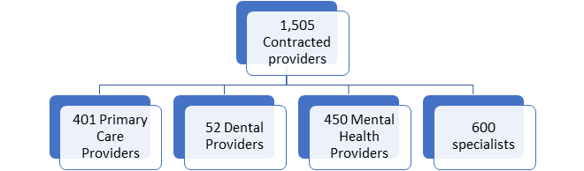
Objective 2: | Develop consent process for UHA to obtain contracted behavioral health provider’s demographic question responses provided in Healthcare Workforce Reporting Survey issued by licensure boards by Q2 2024
COMPLETE
Improve UHA’s REAL+D & SOGI data for Contracted network Providers through integration of OHA’s healthcare Workforce Reporting Program data
UH sent inquiries to OHA and MHACBO on December 19th, 2023: seeking information to strengthen our provider demographic data by matching and pairing taxonomies with Healthcare Workforce Reporting Program data collected via licensing boards through the health care workforce surveys distributed at the time of licensure renewal(s).
The Oregon Health Authority waited for feedback from Oregon Department of Justice on sharing HWRP demographic data through individual consent. The OHA Reporting Analyst was hopeful about their ability to assist Umpqua Health (and possibly other CCOs) through data collection and given some previous informal feedback from DOJ, were optimistic about their ability to do so.
DOJ delivered a memo advising that after review of the relevant statutes and rules governing the HWRP program, that neither OHA nor the licensing Boards have the discretion to share this information beyond the narrow constraints of statue, which allow for release only to law enforcement for enforcement purposes or to OHA for health planning purposes (4a-c here).
Priority Area 3: Increase behavioral health service availability through workforce development​

Slide 102
Objective 3: | Conduct biannual assessment of contracted behavioral health provider’s REAL+D & SOGI data beginning Q2 2024
COMPLETE
Network Demographics
All Behavioral Health Provider Types
June 2024
The Oregon Health Authority allowed UH to obtain an aggregate report on provider demographics which was used to create this data visualization in June 2024.
Priority Area 3: Increase behavioral health service availability through workforce development​

Slide 103
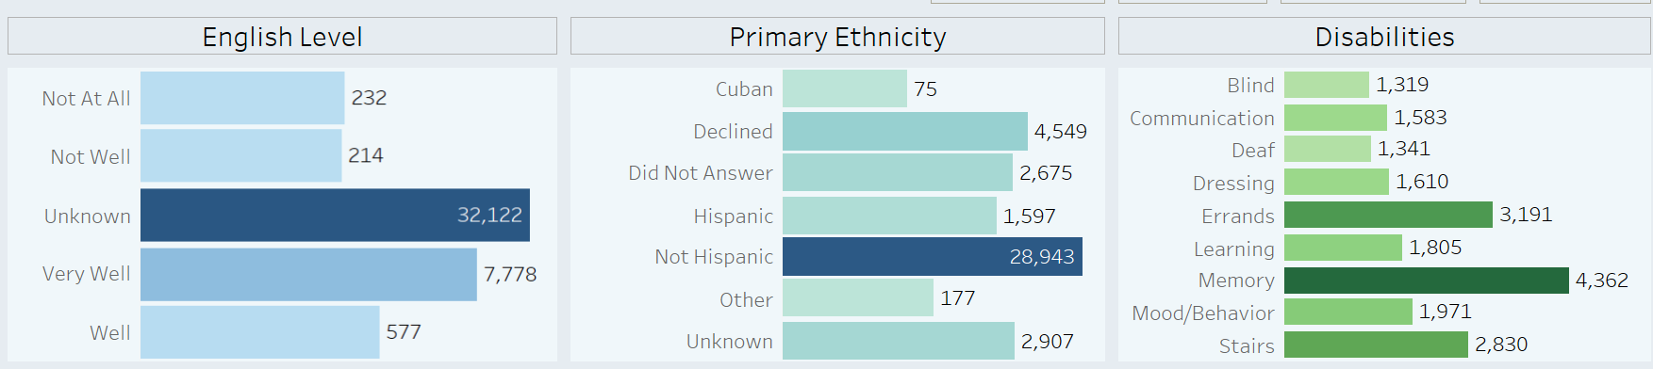
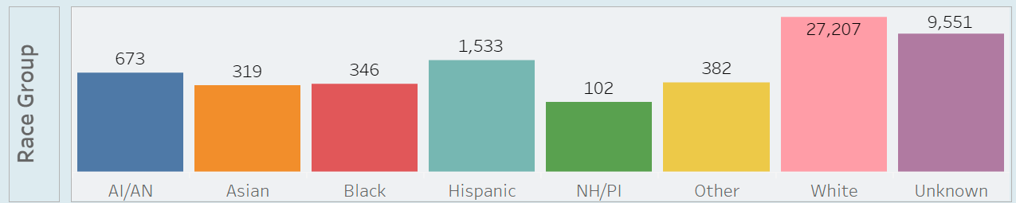
Objective 4: | Evaluate cultural and linguistic responsiveness of contracted behavioral health provider panel by comparing provider to member demographics; report findings to the Behavioral Health Subcommittee by Q4 2024
COMPLETE
Member Demographics
June 2024
Priority Area 3: Increase behavioral health service availability through workforce development​

Slide 104
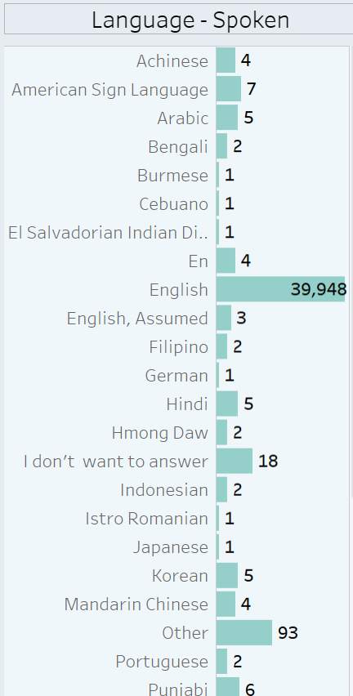
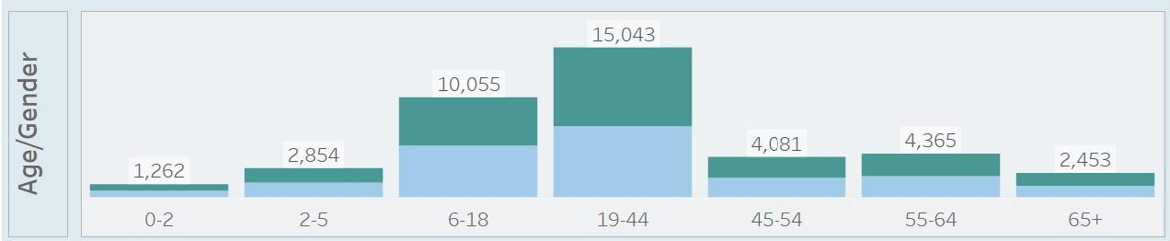
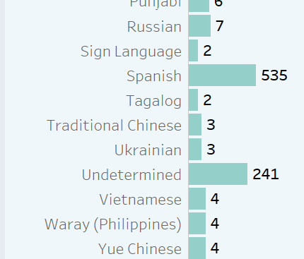
Objective 4: | Evaluate cultural and linguistic responsiveness of contracted behavioral health provider panel by comparing provider to member demographics; report findings to the Behavioral Health Subcommittee by Q4 2024
COMPLETE
Female
Male
Network Demographics
All Behavioral Health Provider Types
June 2024
Priority Area 3: Increase behavioral health service availability through workforce development​

Slide 105
Objective 4: | Evaluate cultural and linguistic responsiveness of contracted behavioral health provider panel by comparing provider to member demographics; report findings to the Behavioral Health Subcommittee by Q4 2024
COMPLETE
Self-reported data from Access to Care Survey of Quarter 3 2024
Priority Area 3: Increase behavioral health service availability through workforce development​

Slide 106

Objective 4: | Evaluate cultural and linguistic responsiveness of contracted behavioral health provider panel by comparing provider to member demographics; report findings to the Behavioral Health Subcommittee by Q4 2024
COMPLETE
Transformation Quality Strategy Data: CLAS HECR Graph 1 demonstrates that the highest proportion of members with interpreter needs are Hispanic members and those in the Unknown race group.
Priority Area 3: Increase behavioral health service availability through workforce development​

Slide 107

Objective 4: | Evaluate cultural and linguistic responsiveness of contracted behavioral health provider panel by comparing provider to member demographics; report findings to the Behavioral Health Subcommittee by Q4 2024
COMPLETE
Transformation Quality Strategy Data: Further analysis of these groups revealed that the majority of Hispanic and Unknown members speak Spanish (See HECR Graphs 2 and 3)
Priority Area 3: Increase behavioral health service availability through workforce development​

Slide 108

Objective 4: | Evaluate cultural and linguistic responsiveness of contracted behavioral health provider panel by comparing provider to member demographics; report findings to the Behavioral Health Subcommittee by Q4 2024
COMPLETE
Transformation Quality Strategy Data: Further analysis of these groups revealed that the majority of Hispanic and Unknown members speak Spanish (See HECR Graphs 2 and 3)
Priority Area 3: Increase behavioral health service availability through workforce development​

Slide 109
Objective 4: | Evaluate cultural and linguistic responsiveness of contracted behavioral health provider panel by comparing provider to member demographics; report findings to the Behavioral Health Subcommittee by Q4 2024
COMPLETE
UH evaluates cultural and linguistic responsiveness of contracted providers by comparing provider information to member/county demographics through various data reporting platforms and Census data.
County race/ethnicity still has highest category of white population, but more individuals’ show ‘unknown’ as compared to recent years
Many service providers (98.8%) do not report demographics.
There appears to be a gap of Black/African identified providers
Only 87% of contracted providers have completed cultural competency training.
CADCs, CHWs, CSWAs, QMHAs, QMHPs have certifications that do not have a regular requirement of this type of training and account for 13% of our contracted providers
The current draft of the most recent report shows:
Priority Area 3: Increase behavioral health service availability through workforce development​

Slide 110
Objective 4: | Evaluate cultural and linguistic responsiveness of contracted behavioral health provider panel by comparing provider to member demographics; report findings to the Behavioral Health Subcommittee by Q4 2024
COMPLETE
38.9% (14/36) of our bilingual providers have submitted proof of language proficiency
1 Romanian, 1 Hindi, 1 Mandarin, 11 Spanish
9 providers are from a behavioral health integrated clinic
Priority Area 3: Increase behavioral health service availability through workforce development​

Slide 111
Intervention 5: | Promote Workforce Development, Training, and Educational Opportunities for Current and Aspiring Behavioral Health Professionals
Solicit provider feedback on desired training topics and host at least one prioritized training topic each quarter in 2024, through the Behavioral Health Subcommittee.​
Enhance provider directory information to begin publishing information on contracted providers available to provide/offer clinical supervision to associate-level behavioral health clinicians​
Provide at least two trainings on Motivational Interviewing in 2024 through partnership with Douglas Public Health Network​
By the end of Q4 2024, increase provider engagement in social emotional workforce development by incentivizing participation. Track the number of providers participating in the workforce development trainings offered.
COMPLETE
COMPLETE
IN PROGRESS
COMPLETE
Priority Area 3: Increase behavioral health service availability through workforce development​

Slide 112
Objective 2: | Enhance provider directory information to begin publishing information on contracted providers available to provide/offer clinical supervision to associate-level behavioral health clinicians
COMPLETE
The Behavioral Health Team has started collecting the data for providers that provide/offer clinical supervision to associate-level behavioral health clinicians though the Social Emotional Asset Mapping deliverable.
Preliminary discussions have been held between the Behavioral Health Team, Contracting, Provider Network, and Credentialing to determine best ways to update and maintain the provider directory with this information, including additional information that helps increase access to care.
In 2025, we will begin to publish information in the provider directory regarding clinician’s ability to offer clinical supervision to associate level practitioners to promote workforce development and provider retention.
Priority Area 3: Increase behavioral health service availability through workforce development​

Slide 113
Objective 3: | Provide at least two trainings on Motivational Interviewing in 2024 through partnership with Douglas Public Health Network​
IN PROGRESS
Due to limitations in schedules, trainings were not held in 2024, but a pre and post test for an "Introduction to Motivational Interviewing" was created in preparation of holding trainings in 2025.
These trainings will be scheduled in 2025, subject to Douglas Public Health Network (DPHN) trainer availability
Priority Area 3: Increase behavioral health service availability through workforce development​

Slide 114

Objective 4: | By the end of Q4 2024, increase provider engagement in social emotional workforce development by incentivizing participation. Track the number of providers participating in the workforce development trainings offered.
COMPLETE
UH Young Children's Workforce Development Scholarship Program
Goal: Increase screening, assessment and therapeutic services for young children 0-5 by CCO contracted providers
Populations of Focus: Primary Care, Integrated Behavioral Health, and Specialty Behavioral Health
Incentives: $20 gift card, Swag, Email Badge and Recognition Across CCO Network
For 2024: $1,000 per provider interested in increasing their capacity, skills, and knowledge to treat children 0-5
  For 2025: $500 per provider
Primary Care Providers, please view this Dashboard
Integrated Behavioral Health Providers, please view this Dashboard
Specialty Behavioral Health Providers, please view this Dashboard
Priority Area 3: Increase behavioral health service availability through workforce development​

Slide 115
Objective 4: | By the end of Q4 2024, increase provider engagement in social emotional workforce development by incentivizing participation. Track the number of providers participating in the workforce development trainings offered.
COMPLETE
Program Launched on October 11, 2024, and through December 10, 2024, UH had the following:
Primary Care Providers: 0
Specialty Behavioral Health Providers: 17
Integrated Behavioral Health Providers: 1​
Community-Based Organizations: 5
Number of Trainings Selected by Providers for 2024: 64, 4 for 2025
Number of Organizations with Providers Registered for Program​: 11
Number of Providers Registered for Program​: 23
Most Popular Selections
Collaborative Problem Solving
EMDR
Trauma-Focused Cognitive Behavioral Therapy
Play Therapy
Priority Area 3: Increase behavioral health service availability through workforce development​

Slide 116
Intervention 5: | Promote Workforce Development, Training, and Educational Opportunities for Current and Aspiring Behavioral Health Professionals
COMPLETE
OHA's CCO Weekly Update
OHA's Holding Hope
OHA's Provider Matters
OHA's 1115 Medicaid Wavier
& Many More
Each month, upcoming statewide trainings are sourced from various newsletters and organizations and socialized within the Umpqua Health Behavioral Health Subcommittee meetings. A summary of upcoming training opportunities is sent out as a document for future reference to our subcommittee members, which includes behavioral health providers, primary care providers, and traditional health workers.
Priority Area 3: Increase behavioral health service availability through workforce development​

Slide 117



Community Engagement Activities
Creating Community Resilience was awarded $19,837 to host trainings educating the community on adverse childhood experiences (ACEs) and resilience as an upstream prevention strategy to reduce health and social issues. Training topics include tobacco cessation, suicide prevention, mental illness, substance use, homelessness, etc.
FARA was awarded $10,000 to support the addition of four TIPS series in 2024 which are free 8-week community-based upstream interventions to the prevention of child maltreatment.
Douglas ESD was awarded $25,000 for two projects: 1. Distribution events to recognize childcare professional workers and 2. Opportunities for childcare center owner/operations to receive funding for updates or equipment.
Umpqua Community College was awarded $19,360 to purchase 440 GED subject tests (110 individuals).
Photo courtesy of the News Review
Priority Area 3: Increase behavioral health service availability through workforce development​

Slide 118

Equitable Access to Behavioral Health Workforce
Performance Improvement Project Goals Include:
Monitor cultural diversity of peers in the UHA service area
Track peer support specialist utilization among Hispanic members within the mental health PIP cohort
Priority Area 3: Increase behavioral health service availability through workforce development​

Slide 119
Equitable Access to Behavioral Health Workforce
UH conducted a Casual Barrier Analysis that included REALD analysis to gain further insights into culturally and linguistically specific barriers to receiving mental health services.
Findings included:
Asian members had the highest proportion of unmet needs followed by those categorized as Unknown and AI/AN.
Individuals aged 65+ had the highest unmet needs followed by 55-64 age group
Priority barriers identified by the Behavioral Health Subcommittee are:
Transportation and access to services in a rural community
Member reluctance to engage in mental health treatment services,
Low access to peer support specialists specifically ones that are culturally diverse
Belief systems on stigma
Interpreter/translator access concerns
Priority Area 3: Increase behavioral health service availability through workforce development​

Slide 120
In 2024: Progress of Dates & Decisions
Quarter 1
Quarter 2
Quarter 3
UH received aggregate report from HWRP on provider network from the HWRP
Collected providers that offer supervision data within our social emotional asset maps for 2024
Quarter 4:
Adapt Integrated Health Care begins the process of selecting a contractor for their Recovery Campus; 6 contractors in the running
Launched digital training library for providers, which will monitor and track all trainings completed, starting with Social Emotional Workforce Development Scholarship Program
CHIP funding scheduled to be announced at the end of December 2024
UH received technical assistance training from ORPRN on ILOS program implementation
Promoted workforce development scholarships funded by Ford Family Foundation regularly in 2024
Quality Improvement department begins collecting language proficiency exams from providers as a component of scholarship program
Continued progressing on implementation plan for provider contraction application (still in progress)
DOJ confirms unable to develop consent process
Priority Area 3: Increase behavioral health service availability through workforce development​

Slide 121
Priority Area 3: Commentary
Goals for Next Year
Many of the interventions set within priority area 3 were achieved between 2024-2025, these completed interventions have been re-evaluated and updated to reflect ongoing population-specific needs.
Intervention 1: Increase access to peer delivered services for individuals with behavioral health needs​
Increase contracted behavioral health peer delivered service providers by 10% in 2025​
Increase utilization of behavioral health peer delivered services by 2% in 2025​
Increase the number of practices that employ peer delivered services in 2025
Intervention 2: Enhance provider capacity to treat eating disorders through partnership with Willamette Nutrition Source​​
Begin monitoring utilization of eating disorder consultation; increase contracted provider utilization of eating disorder consultation with Willamette Nutrition Source by 3%.​
Monitor the number of members treated for eating disorders and target outreach to the top five (5) providers treating eating disorders to provide education on the consultation resources available​
Intervention 3: Increase local training and education opportunities to expand access to evidence-based treatment modalities​
Increase provider's utilization of eating disorder consultation by 50% in 2025
Solicit provider feedback on desired training topics and host at least one prioritized training topic each quarter in 2025, through the Behavioral Health Subcommittee.​
Incentivize provider engagement in trainings designed to enhance social emotional services for young children, Train at least 5 providers through Social Emotional Workforce Development Incentive Program by the end of Q4 2025​
Intervention 4: Increase the cultural and linguistic diversity of contracted behavioral health providers​
Increase number of behavioral health providers with REAL+D and SOGI data by 50% in 2025​
Develop consent process for UHA to obtain contracted behavioral health provider’s demographic question responses provided in Healthcare Workforce Reporting Survey issued by licensure boards by Q2 2025
Conduct biannual assessment of contracted behavioral health provider’s REAL+D & SOGI data beginning Q2 2025
Evaluate cultural and linguistic responsiveness of contracted behavioral health provider panel by comparing provider to member demographics, report findings to the Behavioral Health Subcommittee by Q4 2025
Intervention 5: Develop and promote workforce development, training, and educational opportunities for current and aspiring behavioral health professionals.​
Solicit provider feedback on desired training topics and host at least one prioritized training topic each quarter in 2025, through the Behavioral Health Subcommittee.​
Enhance provider directory information to begin publishing information on contracted providers available to provide/offer clinical supervision to associate-level behavioral health clinicians​
Provide at least two trainings on Motivational Interviewing in 2025 through partnership with Douglas Public Health Network​
By the end of Q4 2025, increase provider engagement in social emotional workforce development by incentivizing participation. Track the number of providers participating in the workforce development trainings offered.
Priority Area 3: Increase behavioral health service availability through workforce development​

Slide 122
2024 Annual Behavioral Health Report Metrics
Wraparound Data Element​ | Count of UHA Members​
Wraparound Eligible Youth​ (Identified as meeting criteria for wraparound as defined by multisystem involvement using the SOC Dashboard)​ | 21​
Wraparound Enrollment​ (UHA Members enrolled in wraparound from among those determined to meet criteria) ​ | 20​
Ethnicity of Youth Enrolled: ​ Number of UHA Members enrolled in wraparound by race​ | Black/Hispanic (1) Native American (1) Hispanic (2)​ Caucasian/Native American/Italian (1)​ Caucasian​ (15)
Language of Youth Enrolled: ​ Number of UHA Members enrolled in wraparound by language​ | English​ (16) Unknown (4)

Slide 123
Thank You.
Behavioralhealthoperations@umpquahealth.com

